Slide 1

Universum – A perspective on Alumni Organizations
Östersund, November 2014

Slide 2
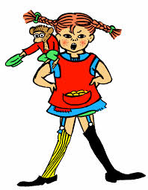


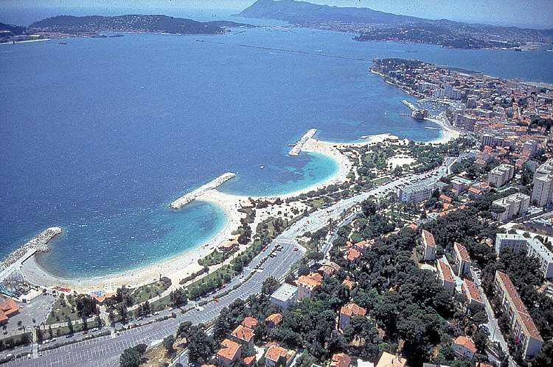


Slide 3



































Universum around the world – annual research
europe
Austria
Belgium
Denmark
Finland
France
Germany
Netherlands
Ireland
Italy
Norway
Poland
Russia
Spain
Sweden
Switzerland
UK
Czech Republic
Ukraine
KNOW
Americas
Brazil
Canada
Mexico
DECIDE
USA
ACT
MIDDLE EAST & AFRICA
Asia/Pacific
South
Africa
Turkey
UAE*
Australia
China
Hong Kong
India
Indonesia
Japan
Malaysia
Singapore
Thailand
Vietnam
*Note, we are also conducting a regional survey in the Middle East, including Saudi Arabia, Kuwait, Qatar, Lebanon, and Egypt, which can be included.
If you are interested in other markets not mentioned here, Universum can conduct tailored surveys in those markets upon request.

Slide 4
Why are Alumni Organizations important?
  Marketing and communication (word of mouth, story telling, etc.) – Alumni + parents = ¼!
  On Campus engagement
    Employer recrutment to Campus, Mentoring, Job shadowing, Lectures, Graduate recruitment
    = Increased university image
  Research projects
  Life-long education – provider of choice for courses
  Fund Raising vs Friendraising
    Direct donation
    Event participation
    Company sponsorship
    Membership fee
  Passion drives support!

Slide 5
University Value Proposition
Alumni Value Proposition
Purpose of Alumni Organization
Expectations & Wishes of Alumni
Alumni Management
Group A
Group B
Group C

Slide 6
University Value Proposition
Market intelligence
Strategy Development
What needs to be changed? How?
Where does management want to be?
How are your competitors perceived?
What do they want?
What do they think of you?
Who is your target?
Internal Identity
What do your employees & students think of you?
Strengths/weaknesses?
Measure

Slide 7
University Value Proposition
Alumni Value Proposition
Purpose of Alumni Organization
Expectations & Wishes of Alumni
Alumni Management
Group A
Group B
Group C

Slide 8
Purpose of the Alumni Organization
Go back to ”Why is Alumni Org. important?”
What do you want from your Alumni?
Purpose of Alumni Organization
University Alumni Responsible
What are your resources?
University Sponsoring
?
Seperate Alumni Organization
?
Self-sustained
Engaged Alumni

Slide 9
University Value Proposition
Alumni Value Proposition
Purpose of Alumni Organization
Expectations & Wishes of Alumni
Alumni Management
Group A
Group B
Group C

Slide 11
University Value Proposition
Alumni Value Proposition
Purpose of Alumni Organization
Expectations & Wishes of Alumni
Alumni Management
Group A
Group B
Group C

Slide 12
Alumni Value Proposition
5. Sustainable
1. Attractive
Alumni
Value
Proposition
4. Distinct
2. True
3. Credible

Slide 13
University Value Proposition
Alumni Value Proposition
Purpose of Alumni Organization
Expectations & Wishes of Alumni
Alumni Management
Group A
Group B
Group C

Slide 14

Alumni ≠ Alumni | Segmentation is key to successful Alumni Management
DACH-Alumni Insights 1-2014
The five stages of the Alumni – life:
(adapted from Rohlmann & Wömperer, 2009):
Young Alumni - 0-3 years of professional experience:
  Close to graduation, characterized by job choice & flexibility
Junior-Alumni – 4-9 years of professional experience:
  Influenced by social consolidation (business & private)
Midlife-Alumni – 10-24 years of professional experience:
  Career progression and social status in focus
Senior-Alumni - >25 years of professional experience:
  Retirement, reflection, social commitment

Slide 15
Actionable recommendations for different alumni life-phases
DACH-Alumni Insights 1-2014
Young Alumni
Junior Alumni
Midlife Alumni
Senior Alumni
• Active incentives to become part of alumni family (ideally pre-graduation)
• Alumni are particularly suitable for Student concepts (e.g. Job Shadowing)
• Identify Dedicated alumni and involve those as Testimonials
• Career Services
• Events & Get-together
• Start Fundraising
• “Executive” Success Stories
• Continuous Education Offerings
• Reflection of own development and life
• Special "Seniors" - meetings & anniversaries
Recommendations for Alumni-Management
Importance of alumni Network
Job search and career advice are key motivations
Tend to be less important as clear focus lies on “stabilization” of career
Importance of the alumni network increases
Maximum awareness and relevance for the Alumni Network
Referral behavior
Tend to be rather negative at the end of study
Recommendation behavior constant; Reflection on study time begins
Recommendation behavior constant, but positive memories are "further away"
Recommendation behavior increases with seniority in career

Slide 16
Be online or be dead!
Connection
Creation
91%
65%
sleep with or next to their phone
4C
GENERATION
upload photos
they have taken
Curation
Community
76%
88%
share content on Facebook
maintain a profile on social network

Slide 17
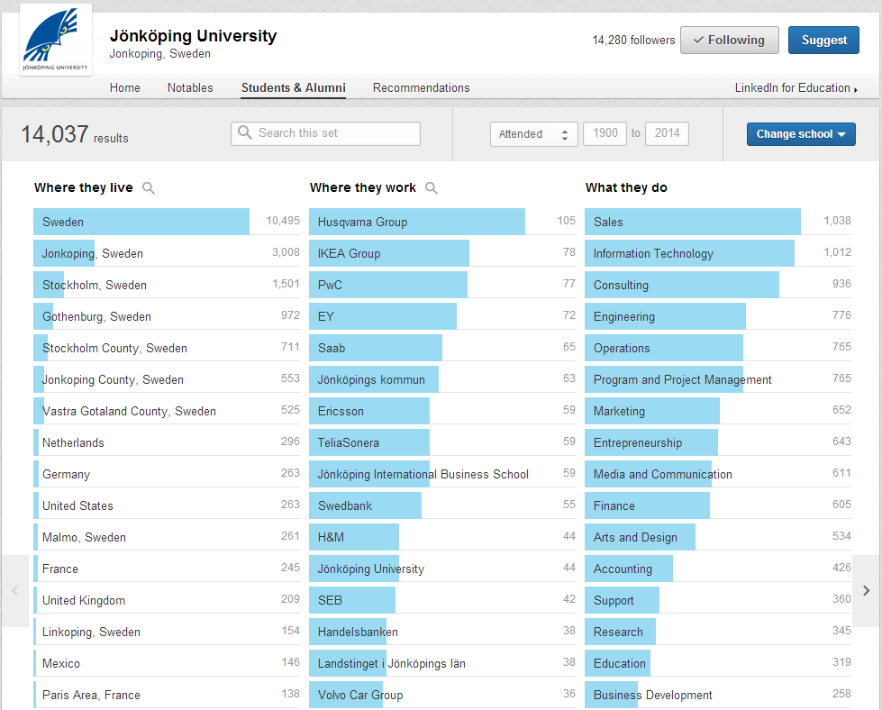


Slide 18
Some thoughts…
They don’t owe you anything!
Focus on the cause, not only the activity: Why, not What!
The rest of their life is in the future, focus on it!
Micro-Volunteering (Share your content on social media, write sporadic articles, etc.)
Classify events such as level 1-3!
Start already at the student level!

Slide 19
Key takings
Three major ways of building a successful alumni network:
  1) Understand yourself & what you want
  2) Understand the different “them”
  3) Create value, create value, create value
And that, my friends, is how you get value!

Slide 20

Thank you!
Alexis Beaussant
Partnership Manager Sweden & Norway
ab@universumglobal.com
+46 737 63 85 57

Slide 21
2014 | Sweden | Business
APPENDIX
Senior vs Young Professionals
Female vs Male Professionals

Slide 22
Career goals
2014 | Sweden | Business
?
Which of these career goals are most important to you? Please select in order of preference, where '1' is most important.
The graph shows career goals chosen as first, second or third choice.

Slide 23
Career goals
2014 | Sweden | Young Professionals
?
Which of these career goals are most important to you? Please select in order of preference, where '1' is most important.
The graph shows career goals chosen as first, second or third choice.

Slide 24
Relative importance of each driver
2014 | Sweden | Business
Young Professional
Senior professional
Employer Reputation & Image
People & Culture
Remuneration & Advancement Opportunities
Job Characteristics
?
How would you rate the relative importance of these aspects when choosing your Ideal Employer? Please divide 100 points between the alternatives in accordance with importance.

Slide 25
Employer Reputation & Image
2014 | Sweden | Business
Attractive attributes
?
Which attributes do you perceive as the most attractive? Please select a maximum of three alternatives.

Slide 26
People & Culture
2014 | Sweden | Business
Attractive attributes
?
Which attributes do you perceive as the most attractive? Please select a maximum of three alternatives.

Slide 27
Remuneration & advancement opportunities
2014 | Sweden | Business
Attractive attributes
?
Which attributes do you perceive as the most attractive? Please select a maximum of three alternatives.

Slide 28
Job Characteristics
2014 | Sweden | Business
Attractive attributes
?
Which attributes do you perceive as the most attractive? Please select a maximum of three alternatives.

Slide 29
Relative importance of each driver
2014 | Sweden | Young Professionals
Total
Female
Male
Employer Reputation & Image
People & Culture
Remuneration & Advancement Opportunities
Job Characteristics
?
How would you rate the relative importance of these aspects when choosing your Ideal Employer? Please divide 100 points between the alternatives in accordance with importance.

Slide 30
Employer Reputation & Image
2014 | Sweden | Young Professionals
Attractive attributes
?
Which attributes do you perceive as the most attractive? Please select a maximum of three alternatives.

Slide 31
People & Culture
2014 | Sweden | Young Professionals
Attractive attributes
?
Which attributes do you perceive as the most attractive? Please select a maximum of three alternatives.

Slide 32
Remuneration & advancement opportunities
2014 | Sweden | Young Professionals
Attractive attributes
?
Which attributes do you perceive as the most attractive? Please select a maximum of three alternatives.

Slide 33
Job Characteristics
2014 | Sweden | Young Professionals
Attractive attributes
?
Which attributes do you perceive as the most attractive? Please select a maximum of three alternatives.

