Slide 1
EQUAL OPPORTUNITIES AT MID SWEDEN UNIVERSITY A BRIEF INTRODUCTION FOR EMPLOYEES
Notes:
EQUAL OPPORTUNITIES AT MID SWEDEN UNIVERSITY
A Brief Introduction for Employees

Slide 2
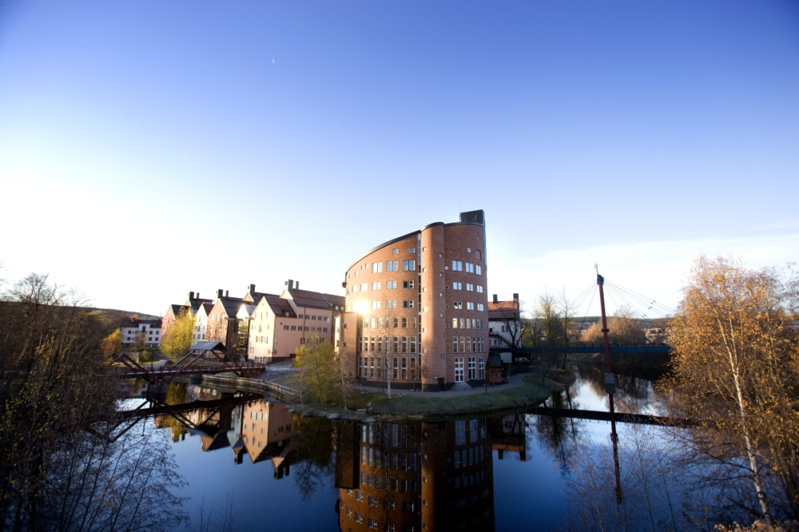
CONTENTS
What are Equal Opportunities?
Legislation and regulations
Central concepts
How do we work at MIUN?
What do I do if I feel discriminated against?
Where can I find further information?
Notes:
Introduction
Welcome as a fellow employee at Mid Sweden University.
It is important to us as your employer that you are given a proper introduction to your new workplace, both with regard to your assignments and to other aspects of your environment. But it is also important that you receive some basic information with regard to some common areas that affect you as an employee and as a colleague.
The purpose of this introduction is to provide new employees, but also employees who have been with us for a while, a brief introduction about what we call Equal Opportunities.
We will talk about the following topics.
What are Equal Opportunities?
The existing legislation and regulations
Central concepts
How do we work at MIUN?
What do I do if I feel that I have been discriminated against?
Where can I find further information?

Slide 3
UNITED NATIONS UNIVERSAL DECLARATION OF HUMAN RIGHTS
”All human beings are born free and equal in dignity and rights."
Notes:
Mid Sweden University is not an isolated island when it comes to taking a stand and working on issues regarding discrimination, harassment and victimisation.
There are a number of different agreements and laws by which both Sweden as a nation and Mid Sweden University are bound.
One of them is the United Nations Universal Declaration of Human Rights.
”All human beings are born free and equal in dignity and rights.”

Slide 4
CHARTER OF HUMAN RIGHTS OF THE EUROPEAN UNION
Chapter 3 Equality
equality before the law,
non-discrimination,
cultural, religious and linguistic diversity,
equality between men and women,
the rights of the child,
the rights of the elderly,
integration of persons with disabilities.
Notes:
In the EU, there are also statutory rights with regard to the freedom and dignity of the individual human being, and also to the obligation of public institutions to combat discrimination against people.
Areas that are included
equality before the law,
non-discrimination,
cultural, religious and linguistic diversity,
equality between men and women,
the rights of the child,
the rights of the elderly,
integration of persons with disabilities
This charter provides the basis for the national legislation, which in turn may vary in terms of form and content in the various countries of the EU.

Slide 5
MY RESPONSIBILITIES AS A GOVERNMENT EMPLOYEE
The public institutions shall combat discrimination of persons on grounds of gender, colour, national or ethnic origin, linguistic or religious affiliation, functional disability, sexual orientation, age or other circumstance affecting the individual.
Notes:
Mid Sweden University is a public authority. According to the Swedish constitution, we, as representatives of the State, shall respect, protect and satisfy all human rights.
The public institutions shall combat discrimination of persons on grounds of gender, colour, national or ethnic origin, linguistic or religious affiliation, functional disability, sexual orientation, age or other circumstance affecting the individual.
As employees at a public authority, you and every other employee at Mid Sweden University have a responsibility to ensure that all individuals are accorded their human rights and that these rights are not violated.

Slide 6
OUR BASIC VALUES AS GOVERNMENT EMPLOYEES
Democracy
Legality
Objectivity and impartiality
Free formation of opinion
Respect
Efficiency and service
Notes:
Starting points
The way in which we act in our daily work shall be based on a number of basic values, which are reflected in our laws and regulations. Based on the legal framework, these common basic values can be summarised in six basic principles.
The first and highest principle is democracy. According to the constitution, all public power in Sweden proceeds from the people.
Other basic principles
Legality, which means that public power is exercised in accordance with the law.
Objectivity and impartiality. The public administration shall take everyone’s equality before the law into consideration in their daily activities; objectivity and impartiality must be observed.
Free formation of opinion. Swedish democracy is founded on the free formation of opinion.
Respect. Public power is to be exercised with respect for the equal worth of all and for the freedom and dignity of the individual.
Finally, the central legislation regarding the national budget and administration makes it clear that efficiency and service are basic values for government employees.

Slide 7
GOVERNMENT REGULATIONS
The Discrimination Act
The Higher Education Act and the Higher Education Ordinance
Gender mainstreaming
Notes:
At Mid Sweden University, we have been given certain conditions by our commissioning agents, the Swedish Government and Parliament, which regulate our activities and which we must take into consideration.
The first is the Swedish Discrimination Act, which contains the general legislation to counteract discrimination.
The Higher Education Act and the Higher Education Ordinance contain some more specific regulations that more directly pertain to our activities.
Finally, there is gender mainstreaming, which is the Swedish Government and Parliament’s strategy for achieving the national gender equality policy objectives.

Slide 8
THE DISCRIMINATION ACT
The purpose of the DISCRIMINATION ACT is to is to combat discrimination and in other ways promote equal rights and opportunities regardless of:
gender
transgender identity or expression
ethnicity
religion or other belief
disability
sexual orientation
age
These are the seven grounds of discrimination.
Mid Sweden University is the workplace of its employees and students alike, which means that the Work Environment Act is also an important part of the work for equal opportunities.
Notes:
Gender
If you have been discriminated against for reasons that are associated with gender, you can report it. The prohibition of gender discrimination also covers people who intends to change or has changed sex.
Transgender identity or expression
Everyone has a gender identity or expression, which is the manner in which a person identifies or expresses themselves through clothes, body language, behaviour or other similar circumstances with regard to gender. Some people deviate from the gender norms constantly or occasionally, for example transvestites or intersexual people.
Ethnicity
According to the law, ethnicity describes a person’s national or ethnic origin, skin colour or other similar circumstances. Everyone has one or more ethnic affiliations. Therefore, everyone may be the victim of ethnic discrimination – the Sámi people, the Romani, people with Swedish, Somali or Bosnian affiliations, etc. Ethnicity is based on self-identification, which means that it is up to the individual to define his or her ethnic affiliations.
Religion and other belief
Everyone who has a religion or other belief is protected by the prohibition against discrimination, for example Muslims, Christians, Buddhists and atheists.
Disability
According to the law, a disability is a lasting physical, mental or intellectual limitation of a person’s functional capacity that as a consequence of injury or illness existed at birth, has arisen since then or can be expected to arise in the future. A disability is something that person has, not something that a person is.
A disability may be more or less noticeable depending on the situation, for example allergies, dyslexia, hearing loss, visual impairment, neuropsychiatric disorders, etc. A person with a disability or disabilities is protected by the law, regardless of the degree of disability, which means that you are protected by the law even if your disability is less severe.
Sexual orientation
Homosexual, heterosexual and bisexual persons can report discrimination that is associated with sexual orientation.
Age
According to the law, age is the length of a person’s life to date. Everyone, regardless of age, can report discrimination that is associated with age.

Slide 9
THE REQUIREMENTS OF THE DISCRIMINATION ACT
Prohibition of various forms of discrimination
Prohibition of instructions to discriminate
Prohibition of reprisals
Obligation to investigate and take measures against harassment and sexual harassment
Active measures; promote equal rights and opportunities
Support and adaption measures for people with disabilities
Notes:
The requirements of the Discrimination Act are in brief:
Prohibition of various forms of discrimination
The Act also contains a prohibition against instructing an employee to discriminate.
A prohibition against subjecting someone to reprisals for having reported discrimination.
The obligation to investigate and take measures in case harassment or sexual harassment has occurred or is suspected to have occurred.
Active measures to promote equal rights and opportunities
Take measures to provide support and adaptation for people with disabilities.

Slide 10
DISCRIMINATION, HARASSMENT AND VICTIMISATION
Direct or Indirect discrimination: someone is unfairly disadvantaged by being treated less favourably than someone else, and this disadvantaging is associated with the grounds of discrimination.
Notes:
The Discrimination Act describes different forms of discrimination.
Direct discrimination: Someone is disadvantaged by being treated less favourably than someone else is treated, has been treated or would have been treated in a comparable situation, if this disadvantaging is associated with one of the grounds of discrimination.
Indirect discrimination: Someone is disadvantaged by the application of a provision, a criterion or a procedure that appears neutral but which in practice and in association with one of the grounds of discrimination may put certain people at a particular disadvantage.

Slide 11
DISCRIMINATION, HARASSMENT AND VICTIMISATION
Inadequate accessibility: a person with disability is disadvantaged through a failure to take measures for accessibility to enable the person to come into a situation comparable with that of persons without this disability
Notes:
Inadequate accessibility: A person with disability is disadvantaged through a failure to take measures for accessibility to enable the person to come into a situation comparable with that of persons without this disability where such measures are reasonable on the basis of accessibility requirements in laws and other statutes, and with consideration to the financial and practical conditions.

Slide 12
DISCRIMINATION, HARASSMENT AND VICTIMISATION
Harassment: violation of a person’s dignity in association with one of the grounds of discrimination, for example exclusion, isolation or offensive comments.
Sexual harassment: unwelcome deliberate touching, groping, jokes, suggestions, looks or images of a sexual nature.
Notes:
Harassment: Conduct that violates a person’s dignity and that is associated with one of the grounds of discrimination, for example exclusion, isolation or offensive comments.
Sexual harassment: Conduct of a sexual nature that violates a person’s dignity, for example unwanted deliberate touching, groping, jokes, suggestions, jargon, or looks or images of a sexual nature.

Slide 13
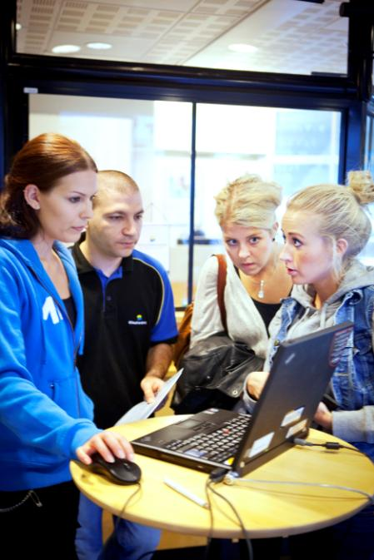
DISCRIMINATION, HARASSMENT AND VICTIMISATION
Victimisation: recurrent reprehensible or distinctly negative actions which are directed against individual employees in an offensive manner and can result in those employees being placed outside the workplace community.
Notes:
Victimisation: The concept can be found in the Swedish work environment legislation, where it is defined as recurrent reprehensible or distinctly negative actions which are directed against individual employees in an offensive manner and can result in those employees being placed outside the workplace community.

Slide 14
THE HIGHER EDUCATION ACT AND THE HIGHER EDUCATION ORDINANCE
HEA Chapter 1
Section 5 Equality between women and men shall always be taken into account and promoted in the activities of higher education institutions.
HEO Chapter 4
Appointment procedure for teachers
Section 5 Gender equality among representatives
Section 6 Opinions on expertise
Notes:
We will also briefly mention how the Higher Education Act and the Higher Education Ordinance regulate the activities of higher education institutions.
HEA Chapter 1
Section 5 Equality between women and men shall always be taken into account and promoted in the activities of higher education institutions.
HEO Chapter 4
Appointment procedure for teachers
Section 5 Equal representation of women and men in any group of individuals who are to submit a proposal on the applicants to be considered for appointment to a teaching post.
Section 6 Opinions on expertise. When the opinions of two or more persons are obtained, both men and women should be represented equally.

Slide 15
GENDER MAINSTREAMING
The principal strategy for achieving the national gender equality policy objectives.
- Women and men are to have the same power to shape society and their own lives
Equal division of power and influence.
Economic equality
Equal distribution of unpaid housework and provision of care
An end to men’s violence against women
Notes:
Finally, there is a third form of regulation for public authorities, namely what is known as gender mainstreaming.
Gender mainstreaming is the principal strategy for achieving the national gender equality policy objectives.
Gender mainstreaming means that decisions in all policy areas and at all levels are to be permeated by a gender equality perspective.
The strategy has been developed in order to counteract the tendency to neglect gender equality issues or consider them secondary to other political issues and activities.
The gender equality policy objectives concern the following.
Women and men are to have the same power to shape society and their own lives.
Equal division of power and influence
Economic equality
Equal distribution of unpaid housework and provision of care
An end to men’s violence against women

Slide 16
EQUAL OPPORTUNITIES AT MID SWEDEN UNIVERSITY
The equal value of all people is a self-evident and basic condition for the activities at Mid Sweden University.
Both employees and students should be met and treated with respect and dignity and the university should make full use of differences to support the individual’s possibilities to work or study, and to develop the activities at Mid Sweden University.
We call the work on these issues ”Equal Opportunities”.
Equal Opportunities comprises the work that we do to create a good work and study environment that is free from discrimination, harassment and victimisation.
Notes:
The equal value of all people is a self-evident and basic condition for the activities at Mid Sweden University.
Regardless of whether you are an employee or a student, you should be met and treated with respect and dignity and the university should make full use of differences to support the individual’s possibilities to work or study.
We call the work on theses issues ”Equal Opportunities” and it is a part of the university’s quality and development work. Equal Opportunities comprises the work that we do to create a good work and study environment that is free from discrimination, harassment and victimisation.

Slide 17
EQUAL OPPORTUNITIES AT MID SWEDEN UNIVERSITY
To work for equal opportunities is to work with knowledge, attitudes, values and behaviour.
It is also about observing and highlighting non-equal and equal norms and power structures in order to enable change.
This work should be deeply rooted in Mid Sweden University and be integrated in the daily tasks of all activities.
Notes:
The Equal Opportunities work includes the prevention of any employee or student being subjected to discrimination, harassment or victimisation.
To work for equal opportunities is to work with knowledge, attitudes, values and behaviours.
It is also about observing and highlighting non-equal and equal norms and power structures in order to enable change.
There is also a dimension of development involved in the Equal Opportunities work, both with regard to the individual and the activities. It is part of our strategic quality and development work.
That is why it is important that the Equal Opportunities work is deeply rooted in Mid Sweden University and integrated in the daily tasks of all activities.

Slide 18
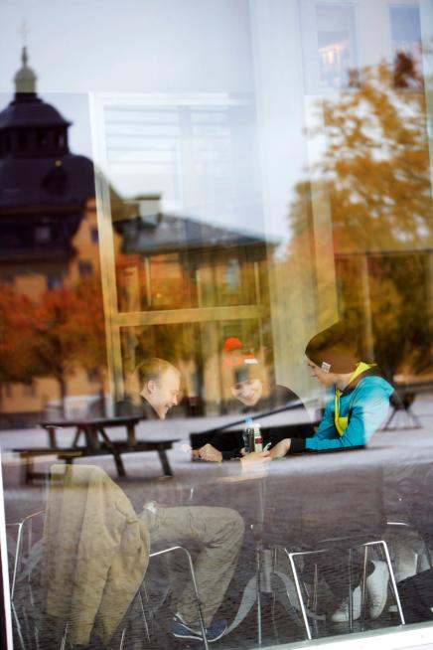
RESPONSIBILITIES AND ROLES IN THE EQUAL OPPORTUNITIES WORK
The Vice-Chancellor is ultimately responsible.
The Chairperson of the Strategy Group for Equal Opportunities
The Strategy Group for Equal Opportunities
Representatives of the managers, trade union organizations and students
Equal opportunities coordinator provides support for the organization, and is responsible for the coordination of development and follow-up, and the handling of cases
The Head of Department is responsible for the activities
Equal opportunities representatives support the work
Notes:
The Chairperson of the Strategy Group for Equal Opportunities is responsible for organizing the Equal Opportunities work, by order of the Vice-Chancellor.
The Strategy Group for Equal Opportunities is responsible for creating strategies for the Equal Opportunities work. The strategy group supports the Vice-Chancellor in matters concerning equal opportunities and is responsible for proposing strategies and a central action plan.
The equal opportunities coordinator works with developing, coordinating and following up activities relating to the equal opportunities work at the university, and is also responsible for handling current cases involving equal opportunities issues. The equal opportunities coordinator should also support the university’s management, managers, employees and students in matters concerning equal opportunities.
The Head of Department or equivalent is responsible for the equal opportunities work in his or her area of responsibility.
Each part of the organization will annually draw up, carry out and follow up a local measurement programme for equal opportunities. They will also set aside time and financial resources for this work.
The equal opportunities representatives are a part of the employer’s management resources. Their primary role is to support the managers with regard to observing and promoting equal opportunity aspects in decision-making processes as well as the daily activities of the university. There are three equal opportunities representatives; one to represent each faculty and one to represent the Administration, Library and Faculty Offices.

Slide 19
PLANNED AND SYSTEMATIC WORK
EQUAL OPPORTUNITIES ACTION PLAN 2014-2016
Activities decided on by the Vice-Chancellor that are aimed at creating more equal opportunities for both employees and students
The departments/Administration/Library shall develop local measurement programmes for equal opportunities, which shall be based on local conditions.
The work with the local measurement programmes shall be based on the results of Nöjd studentindex (Satisfied student index), the results from the psycho-social environment survey, and course evaluations, among other things.
Will be followed up in the context of the regular follow-up of the activities.
Notes:
How do we work with these issues at Mid Sweden University?
It is important that the work is planned and systematic.
The follow-up, analysis and planning that is conducted provides the basis for an Equal Opportunities Action Plan, which is decided on by the Vice-Chancellor. It contains a number of measures, both general ones and ones that are more specifically aimed at the individual grounds of discrimination.
Each department then focuses on breaking down the central plan in order to develop and conduct activities on a local level. These activities are based on the results of Nöjd studentindex (Satisfied student index), the results of the psycho-social environment survey, and course evaluations, among other things.
This work will then be followed up in the context of the regular follow-up of the activities.

Slide 20
CAUSES AND CONSEQUENCES
Important to know the causes and consequences in order to prevent such issues from occurring. Potential causes may be
The abuse of power
Values and norms
Flaws in the work environment
Ignorance
Consequences for both the individual and the group/organisation.
Notes:
It is important to know the potential causes and consequences of discrimination, harassment and other forms of victimisation.
The are many potential causes;
For example, such actions may be related to the abuse of power or jealousy.
Prevailing power structures and norms may be causes of discrimination, harassment and victimization in a workplace.
Other potential causes are structural flaws in the work environment, such as indistinct goals, unclear or unspoken rules, routines, and inadequate work on values.
Temporary differences of opinion, conflicts or difficulties in cooperation are not uncommon in workplaces and do not necessarily involve discrimination or harassment in the legal sense. However, there are a number of situations where comments or actions intentionally or unintentionally, due to ignorance, may cause hurt and offense.
When someone is subjected to some form of discrimination or victimization, there are consequences not only for the victim. The psychosocial climate and solidarity of the group are negatively affected and it may lead to decreased efficiency, more absences due to illness and a higher staff turnover.

Slide 21
IF YOU ARE SUBJECTED TO DISCRIMINATION OR HARASSEMENT
If you as an employee are subjected to discrimination, harassment or another form of victimisation, or if you witness another employee or a student being subjected to such treatment, you should primarily contact your immediate superior, the equal opportunities coordinator or the equal opportunities representatives.
There are also other roles to whom you can turn for advice, support and information:
The work environment administrator/HR specialist
The legal expert
The union representatives
The safety representative
The Occupational Health Service
The Equality Ombudsman
Notes:
If you as an employee are subjected to discrimination, harassment or any other form of victimisation, or if you witness another employee or student being subjected to such treatment, you should primarily contact your immediate superior, the equal opportunities coordinator or the equal opportunities representatives.
There are also other roles to whom you can turn for advice, support and information:
◦ The work environment administrator/HR specialist
◦ The legal expert
◦ The union representatives
◦ The safety representative
◦ The Occupational Health Service
◦ The Equality Ombudsman

Slide 22
IF YOU ARE SUBJECTED TO DISCRIMINATION OR HARASSEMENT
If you want to make a formal report, it must be made in writing or sent via e-mail to the Mid Sweden University legal expert or equal opportunities coordinator. You can also turn directly to the government agency The Equality Ombudsman (Swedish: DO).
Notes:
Formal report:
If you want to make a formal report, it must be made in writing or sent via e-mail to the Mid Sweden University legal expert or equal opportunities coordinator. You can also turn directly to the government agency The Equality Ombudsman (Swedish: DO).

Slide 23
IF YOU ARE SUBJECTED TO DISCRIMINATION OR HARASSEMENT
Some examples of what you can do if you feel that you have been offended:
• If possible, depending on the situation, make it clear that you do not appreciate the “joke”, the action or the behaviour. You are not to blame and you should not have to endure unwanted treatment.
• Tell someone what has happened: a colleague or someone else that you trust.
• Inform your superior of the problem as soon as possible, otherwise it may easily grow bigger.
• Write down your experience of the situation – it will make it easier for you if you later decide to make a formal report against the offender. Make a note of each occurrence, including the time, place and possible witnesses, as well as what happened and how you experienced it.
Notes:
As the subject of offensive treatment, it is easy to feel that you are at a disadvantage and it can be difficult to handle the situation. You may feel like you are imagining things, you may blame yourself, you may doubt that others will take you seriously or fear reprisals.
Here are some examples of what you can do if you feel that you have been offended:
If possible, depending on the situation, make it clear that you do not appreciate the “joke”, the action or the behaviour. You are not to blame and you should not have to endure unwanted treatment.
Tell someone what has happened: a colleague or someone else that you trust.
Inform your superior of the problem as soon as possible, otherwise it may easily grow bigger.
Write down your experience of the situation – it will make it easier for you if you later decide to make a formal report against the offender. Make a note of each occurrence, including the time, place and possible witnesses, as well as what happened and how you experienced it.

Slide 24
FURTHER IMFORMATION ABOUT EQUAL OPPORTUNITIES
Further information about Equal Opportunities can be found on the Staffnet under Support: http://www.miun.se/en/staffnet/stod/equality
There you will find the contact information for the equal opportunities coordinator and the equal opportunities representatives, whom you can contact if you have any questions about equal opportunities.
Administrative Procedures for the Work against Discrimination, Harassment and Other Forms of Victimisation
The folder ”Work for Equal Opportunities” contains information about victimisation, harassment and discrimination
Notes:
This is the end of this introduction.
You can find the information that we have talked about today and more on the Staffnet under Support/Equal Rights.
There you will also find the contact information for the equal opportunities coordinator and the equal opportunities representatives, whom you can contact if you have any questions about equal opportunities.
You will also find the ”Administrative Procedures for the Work against Discrimination, Harassment and Other Forms of Victimisation”, as well as the folder ”Work for Equal Opportunities”, which contains some general information about victimisation, harassment and discrimination.

Slide 25
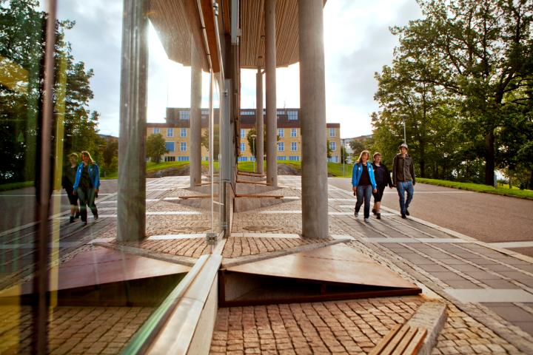
FINALLY
We are each other’s work environment! Together, you and I can create the work environment that we would like to have at Mid Sweden University. It should be a work environment that is free from discrimination, harassment and other forms of victimisation.
Notes:
And finally:
We are each other’s work environment! Together, you and I can create the work environment that we would like to have at Mid Sweden University. It should be a work environment that is free from discrimination, harassment and other forms of victimisation.
Thank you for listening!

