Slide 2
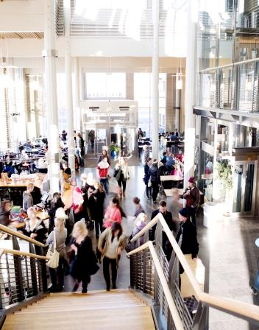
Short summary 2014
  13 000 Students
  450 Independent courses
  46 Educational programs
  30 Master programs
  190 Graduate students
  1 000 Employees
  91 Professors
  928 Million SEK turnover

Slide 3
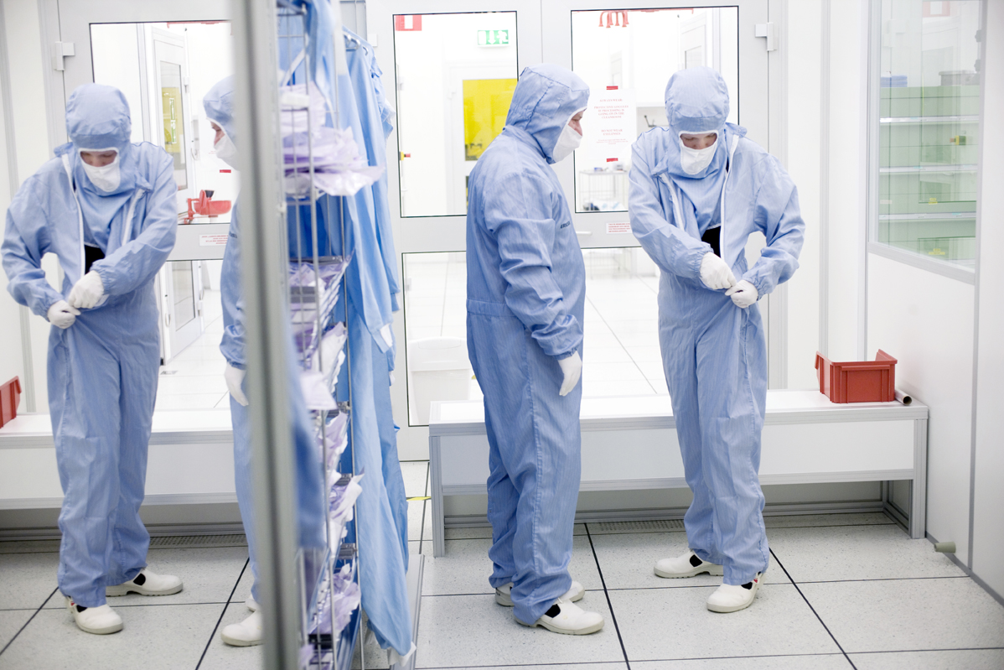
Research with high quality and
co-production

Slide 4
Research development 2003–2013
PhD Students
Government funding (MSEK)
External funding (MSEK)
Professors

Slide 5
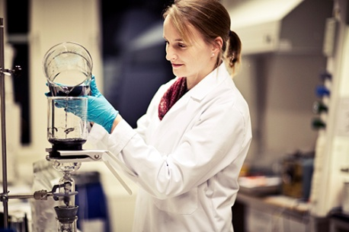
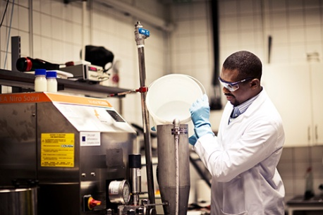
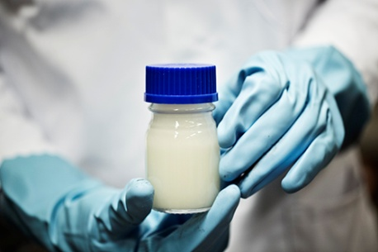

FSCN – Fibre Science and Communication Network
Established in 1999
Sundsvall, Härnösand, Örnsköldsvik
70 Researchers
SEK 70 million
5-10 PhD/ Licentiate exams p.a.

Slide 8

Mission of FSCN
Support industry to improve profitability
Develop new product opportunities
Key competence: Manufacturing processes

Slide 9
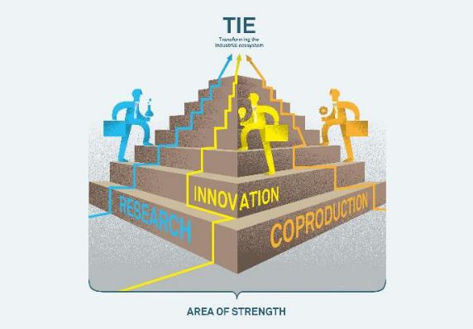

TIE - Transforming the Industrial Ecosystem
Exploit the competitive advantages of the region
Choose opportunities from a global perspective
Use information technology as a key enabler
Adapt to changing markets
Supply competence and skills
Profile the most exciting future opportunities

Slide 10
8 Research Groups at FSCN
Bioenergy
Complex Materials
Digital Printing Centre
Eco-Chemistry
High-Yield Pulping Technology
Materials Physics
Organic Chemistry
Surface and Colloid Engineering

Slide 11
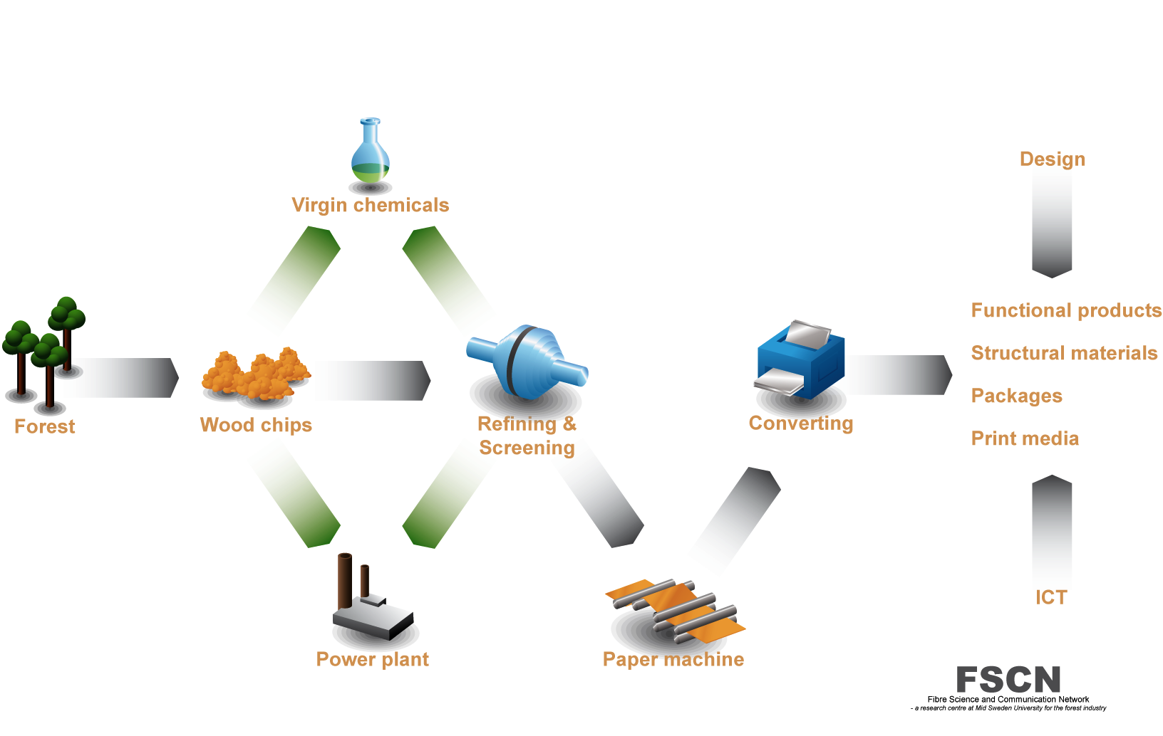

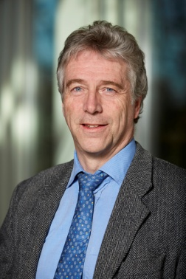
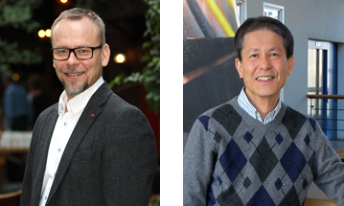



Research goals for 2015
e2mp
KM2
FORIC
Miljöhorisont
New Cellulosic Materials
Notes:
e2mp, FORIC and KM2 are running
Adv Paper Materials → ”New cellulosic materials” to connect fibre chemistry, paper physics and mech pulp
Bio-economy, energy, water, environment → Miljöhorisont: Regional devel, larger scope than FSCN

Slide 12
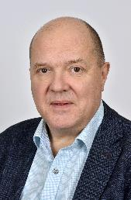




Strategic Initiatives
Energy Efficient mechanical pulping (e2mp) www.e2mpi.se
  E2mp – i
  E2mp – ox
  E2mp - rp
Advanced Paper Materials (KM2)
  Keps
  Coat
  Paper Solar Cells
  Lithium Batteries
  Modulit
  Forest as a Resource Industrial College (FORIC)

Slide 13
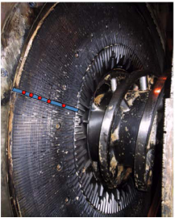
Energy-efficient Mechanical Pulping
The Core of FSCN’s research and co-production
Research goal: Reduce electrical energy use by 50%
Effect on research profile: Keep international leadership in High-Yield Pulping
Support to TIE:
  Use of wood in bioeconomy → FORIC
  New applications = AHYP → New Cellulosic Materials
e2mp

Slide 14
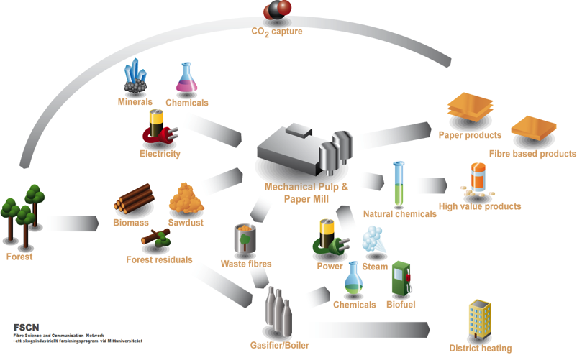
Forest as resource industrial Research college
Co-production with a broad range of different companies
Goal: Competence for companies working in the bioeconomy sector
Effect on research profile
  Develop regional and national visibility
  Stronger synergies within Mid Sweden University
Support to TIE vision
  Support regional renewal with the innovation system BBA
  Regional value from BioInnovation
FORIC

Slide 15

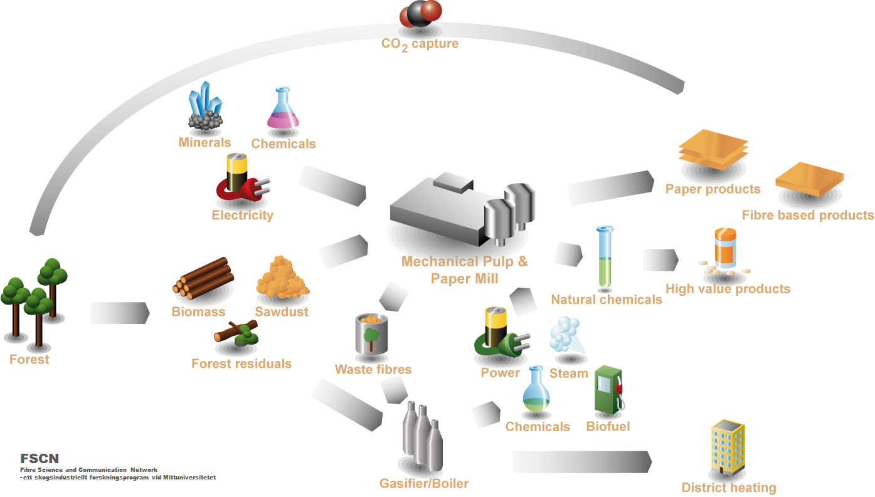

Foric – Forest as a resource industrial research college
Sylvestris
Tärnsjö garveri
Innventia
Skogforsk
Valmet
Pulp Eye
SCA Forest Products
Stora Enso
Kvarnsveden
MoRe research
SCA Timber
Frontway
SenseAir
Mantex
Ragn Sells
Sundsvall Energi

Slide 16
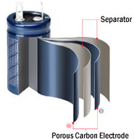
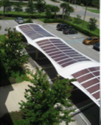
Large functional surfaces
Build industrial network of material and equipment manufacturers
Research goal: Manufacturing and applications for
  Renewable energy systems (Harvest and Store)
  IT services → EISS
Effect on research profile
  International leadership in Nanomaterials Systems
  Strong synergy of STC and FSCN
Support to TIE vision
  Aim at new industrial manufacturing (of “paper”)
  Exploit global transition to renewable energy
KM2

Slide 17

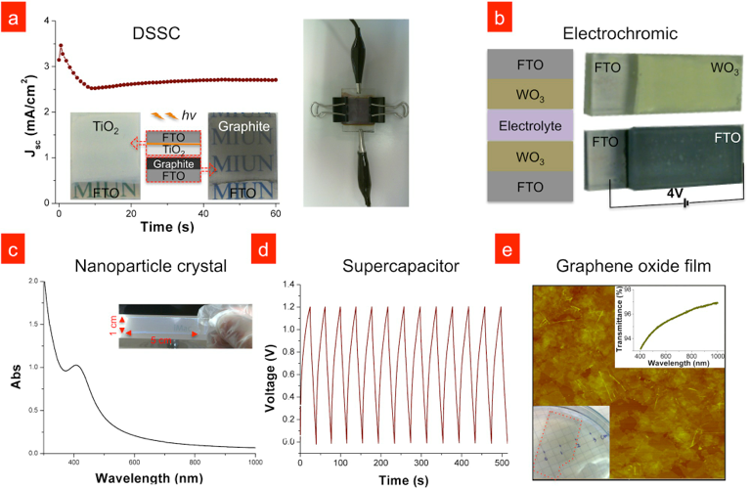
KM2 – Harvest and store Electricity
Prof. Olin

Slide 18

New cellulosic materials
Expand FSCNs industrial network
Goal: Research program on advanced biomaterials
  Water-based cellulose dissolution
  Fibrous materials: FNMech and AHYP
Effect on research profile
  National (BioInnovation) and international visibility
  Link our competence on High-Yield Pulping etc. with KM2
Support to TIE vision
  Regional value from BioInnovation
  Prototyping platform with BBA
New Cellulosic
Materials

Slide 19
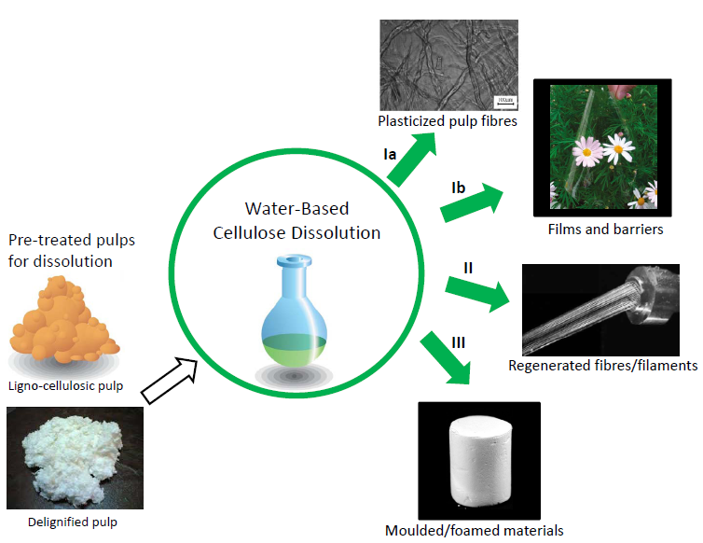
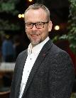
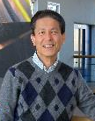
New Cellulosic materials
Prof.
Norgren
Prof.
Uesaka

Slide 20







Spin-offs and partners
hysch
Concrete
new business
World-class science
Unique support to industry
Notes:
FSCN has a mission with 3 ”legs”. The corresponding vision = broader Industrial collaboration, more ambitious and international Science, and personal engagement in the transformation of the forest-based industrial ecosystem

Slide 21
Forest as a resource

