Slide 1
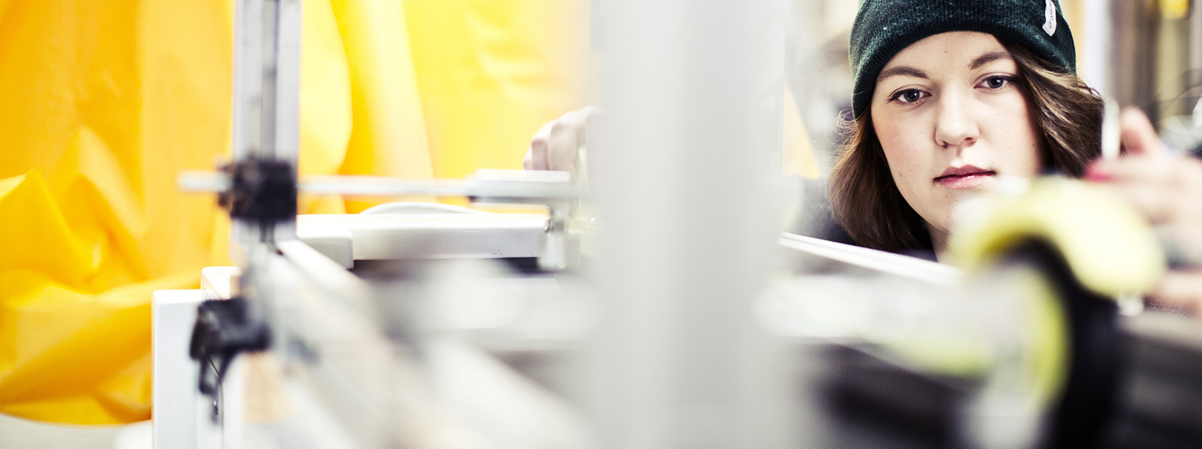
Poster and presentation

Slide 2
One poster for each project group (Successfull UX, 2 posters)
Follow the template and the instructions on heading, fontsize and so on
A short and interesting heading that explains your project
The names of the people in your group
Within your project group you agree on what are the most important and interesting things to view at the poster (about the project, your goals…)
What can interest the people looking at the poster so that they would like to know and hear more about your project?

Slide 3
To think about!
Not to much text. A lot of body text can be hard to read and can make the reader lose his/her interest
Remember that you will do an presentation so you will have
the opportunity to talk more about your project, what you
have done, goals, the techniqal solutions and so on.

Slide 4
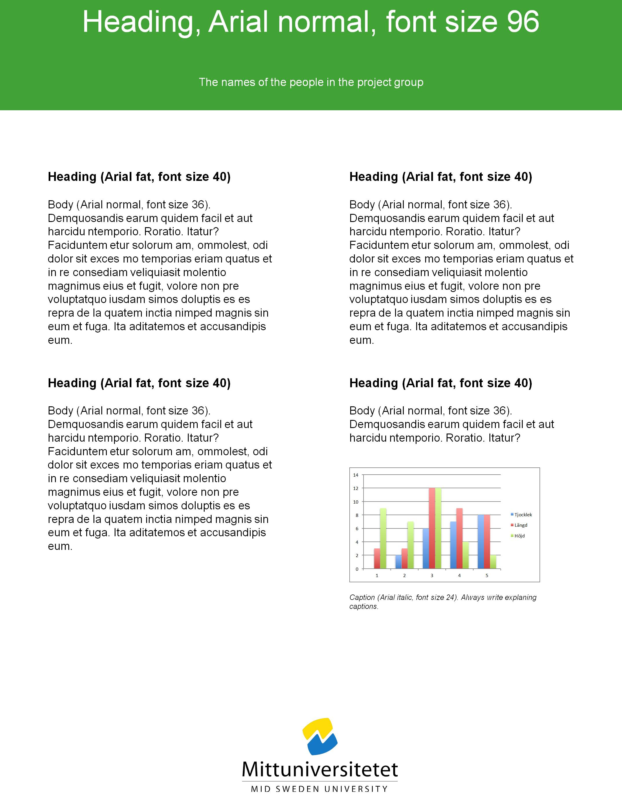

Slide 5
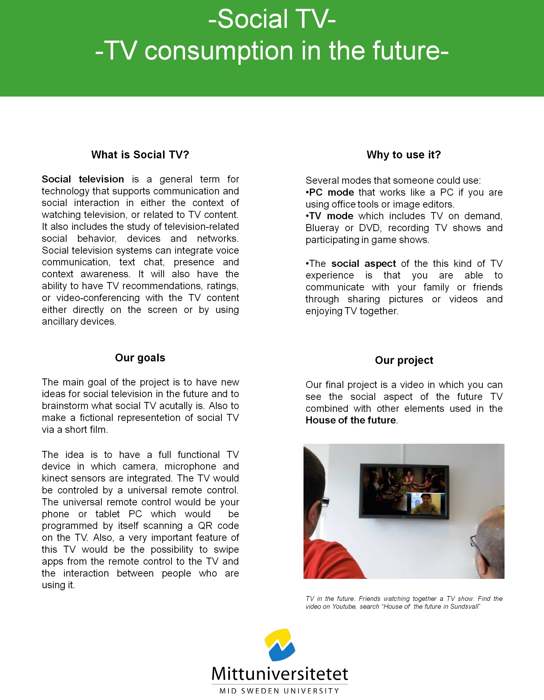

Slide 6
Poster to print
Deadline posters, Tuesday 18 August, 14:00
Save it as at PPTX and send it to me in time, please do not make any other changes ^{with the file or the content.}
Send your poster to me, linda.andersson@miun.se
I will bring your posters to the room the day of the final presentations
Template at: http://www.miun.se/en/education/summeruniversity/schedule
^{Download to open!}
^{Good Luck!}

Slide 7
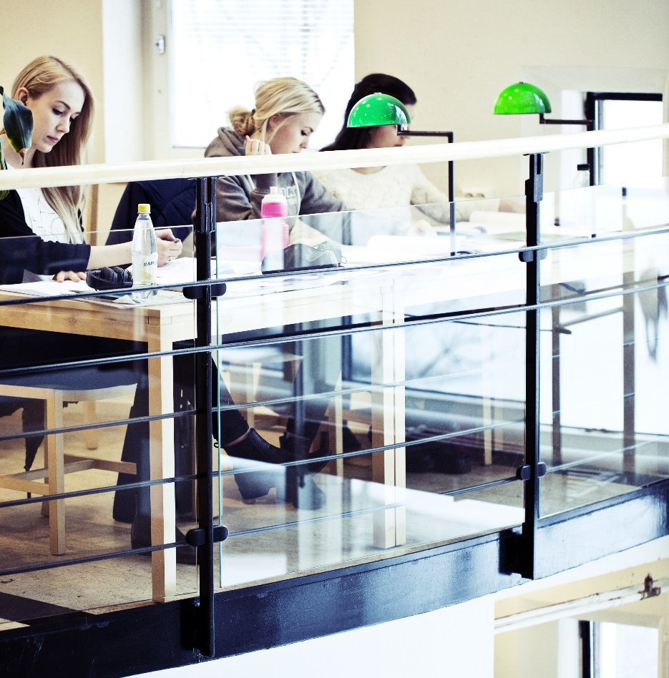
The Presentation
Present the ideas and the results of your project work orally.
All students in the group are supposed to talk during the presentation. For example you can make a PowerPoint
20 minutes for presentation and 10 minutes for questions from the lecturers and the others (30 minutes/group)

