Slide 1
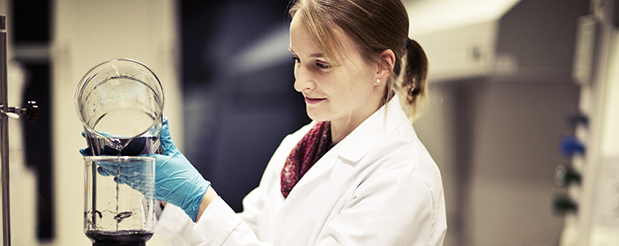
Mittuniversitetet
Fibre Science and Communication Network FSCN

Slide 2

Mid Sweden University 2014
  13 000 Students
  450 Independent courses
  46 Educational programs
  30 Master programs
  190 Graduate students
  1 000 Employees
  91 Professors
  928 Million SEK turnover

Slide 3
Research development at Mid Sweden University
PhD Students
Government funding (MSEK)
External funding (MSEK)
Professors

Slide 4
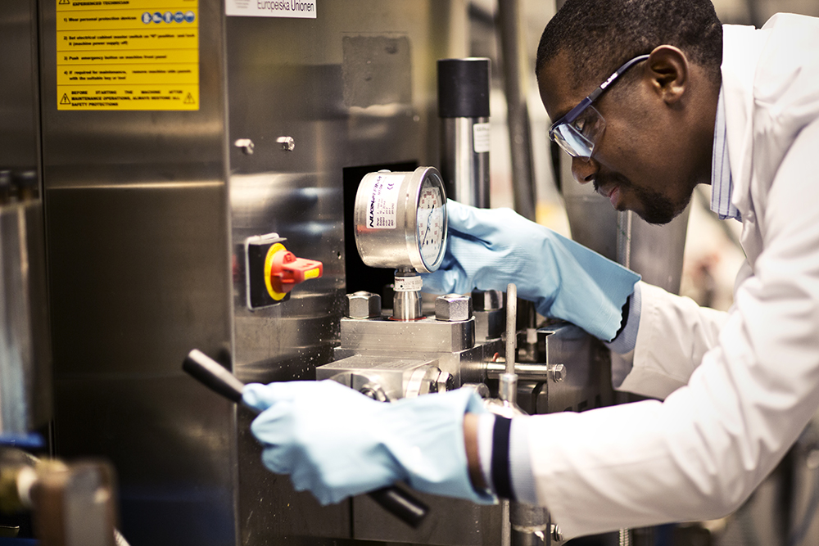
FSCN - Research on manufacturing processes and new bio-based products
  Established in 1999
  Sundsvall Härnösand Örnsköldsvik
  70 Researchers
  70 MSEK
  5-10 PhD Exams / Licentiate exams p.a.

Slide 5
Personnel development FSCN

Slide 6
Funding FSCN

Slide 7
Mission of FSCN
Concrete
new business
  Support industry to improve profitability
  Develop new product opportunities
  Key competence – manufacturing processes
World-class science
Unique support to industry

Slide 8
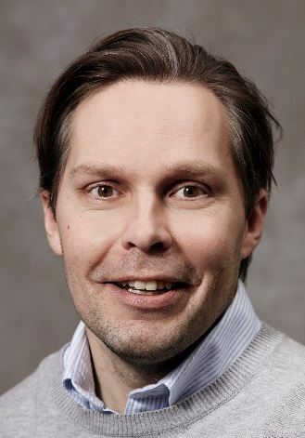
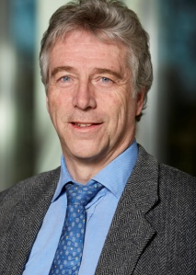
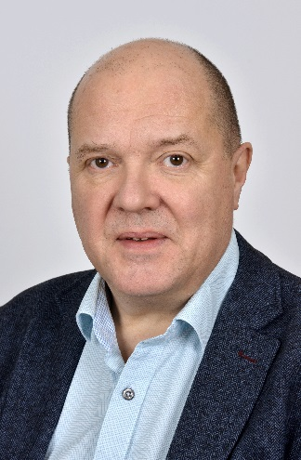
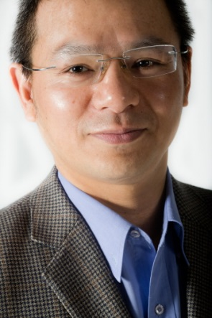
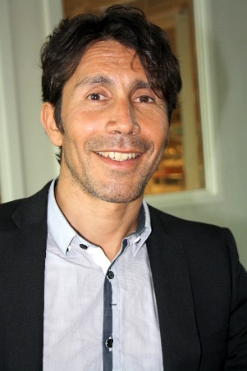
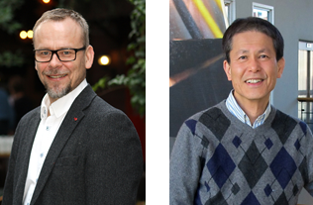

8 Research Groups
  Digital Printing Centre
  High Yield Pulping Technology
  Materials Physics
  Bio energy
  Organic Chemistry
  Surface and Colloid Engineering
  Complex Materials
  Eco Chemistry

Slide 9
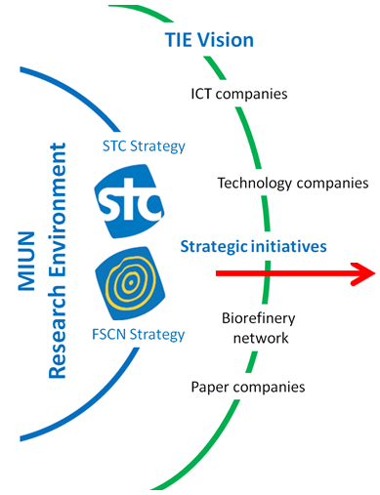
Research Environment with a mission and vision to support Transformation of the Industrial Ecosystem
New strategic position
Joint vision for STC and FSCN Centres
Competence – strong research environment
Content – strategic research program
Coproduction – strong culture
→ Research Environment for Transformative Technologies

Slide 10


Strategic Framework
¹ Analysts and consultants call on businesses to create more value through innovation, yet most companies have been optimized to provide greater efficiency, not greater innovation. As a result, any innovation-driven strategy will likely falter unless we fundamentally reframe our strategic thinking.
¹ In particular, we must regrind our lenses to monitor the periphery, that is, the edges, of our business. At these edges lie our richest opportunities for value creation and our strongest protection against value destruction.
Core – resource efficiency
Edge – new businesses

Slide 11
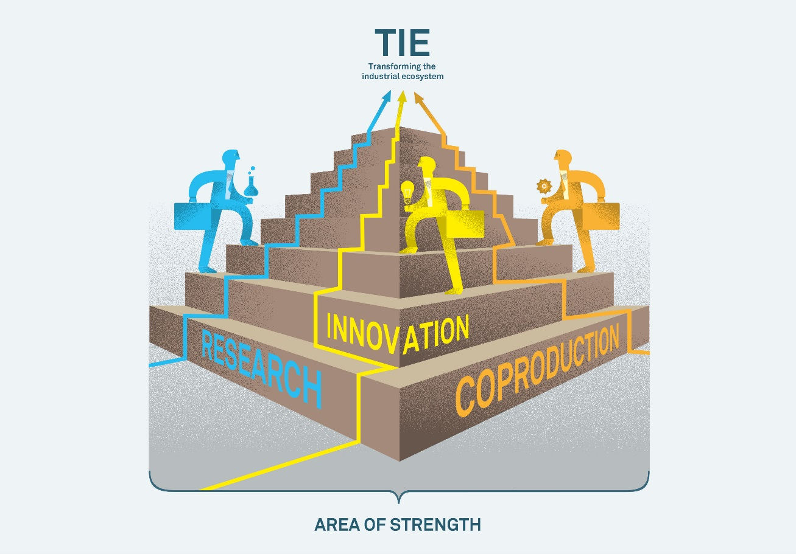




Vision – Transforming the Industrial Ecosystem

Slide 12
Portfolio
Transformative Technologies
e2ctmp
Paper
Solar Cells
HENSU
TINA
SURF
e2mp-rp
ASIS
DEFINE
ENCCP
MOVEMents
JANAND
SURF
FNMech
kW Converter
AHYP
GRIT
JOKER
X-COAT
New Cellulosic
Material
KM2
e2mp
EISS
Measurement
Systems
KM2CHAMP
FLIS
M2M
DICE
BRESCIA
FLIS
FAAN
TRANSFORM
Light-Weight
LEAP
TISIM
ID-POS
DUVA
TAIWAN
DAWN
DUVA
= Existing actions
FORIC – Research School
= Workplan 2015
Education development
= Proposals recruitment
Competence at FSCN and STC
= Proposals research

Slide 13
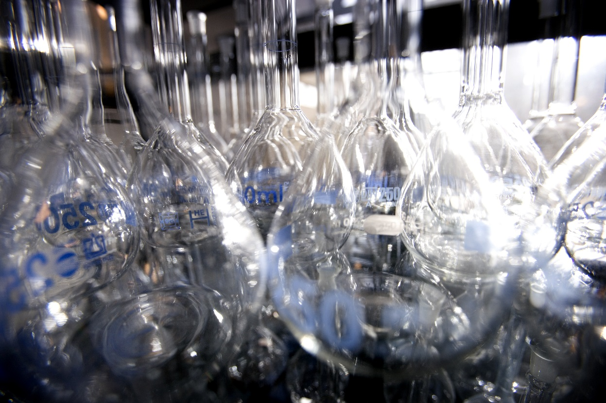
Strategic actions FSCN
energy-efficient mechanical pulping (e2mp) www.e2mpi.se
Large functional surfaces (KM2)
  Paper-based Supercapacitors
  Paper Solar Cells
  Lithium Batteries
  Modulit
3. Forest as a resource industrial college (FORIC) www.miun.se/foric
4. New cellulosic Materials

Slide 14

e2mp – energy-efficient mechanical pulping
The Core of FSCN’s research and co-production
Research goal: Reduce electrical energy use by 50% in pulp production
Effect on research profile: Keep international leadership in High-Yield Pulping
Support to TIE vision
  Use of wood in bioeconomy → FORIC
  New applications = AHYP → New Cellulosic Materials

Slide 15
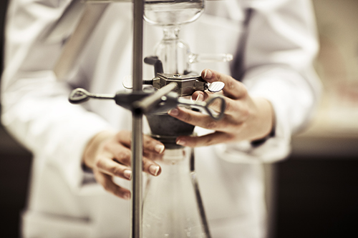
KM2 – Harvest and store energy on large functional surfaces
Build industrial network of material and equipment manufacturers
Research goal: Manufacturing and applications for
  Renewable energy systems (Harvest and Store)
  IT services → EISS
Effect on research profile
  International leadership in Nanomaterials Systems
  Strong synergy of STC and FSCN
Support to TIE vision
  Aim at new industrial manufacturing (of “paper”)
  Exploit global transition to renewable energy

Slide 16
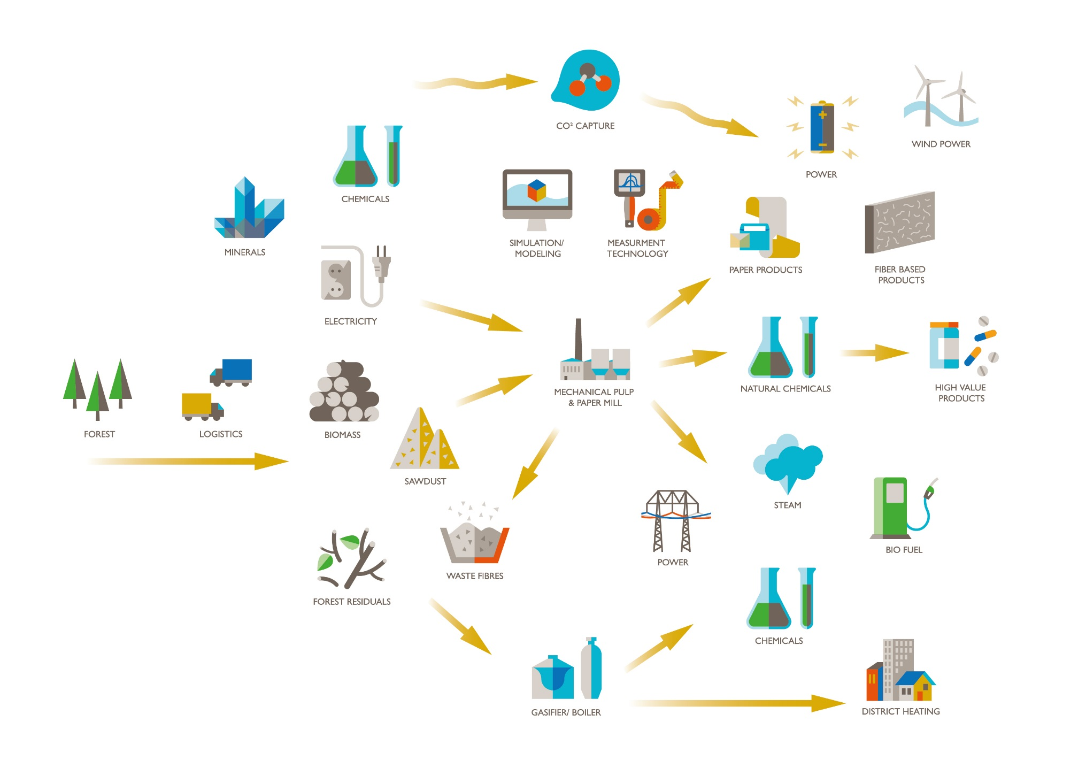
FORIC
Forest as a resource industrial research college

Slide 17
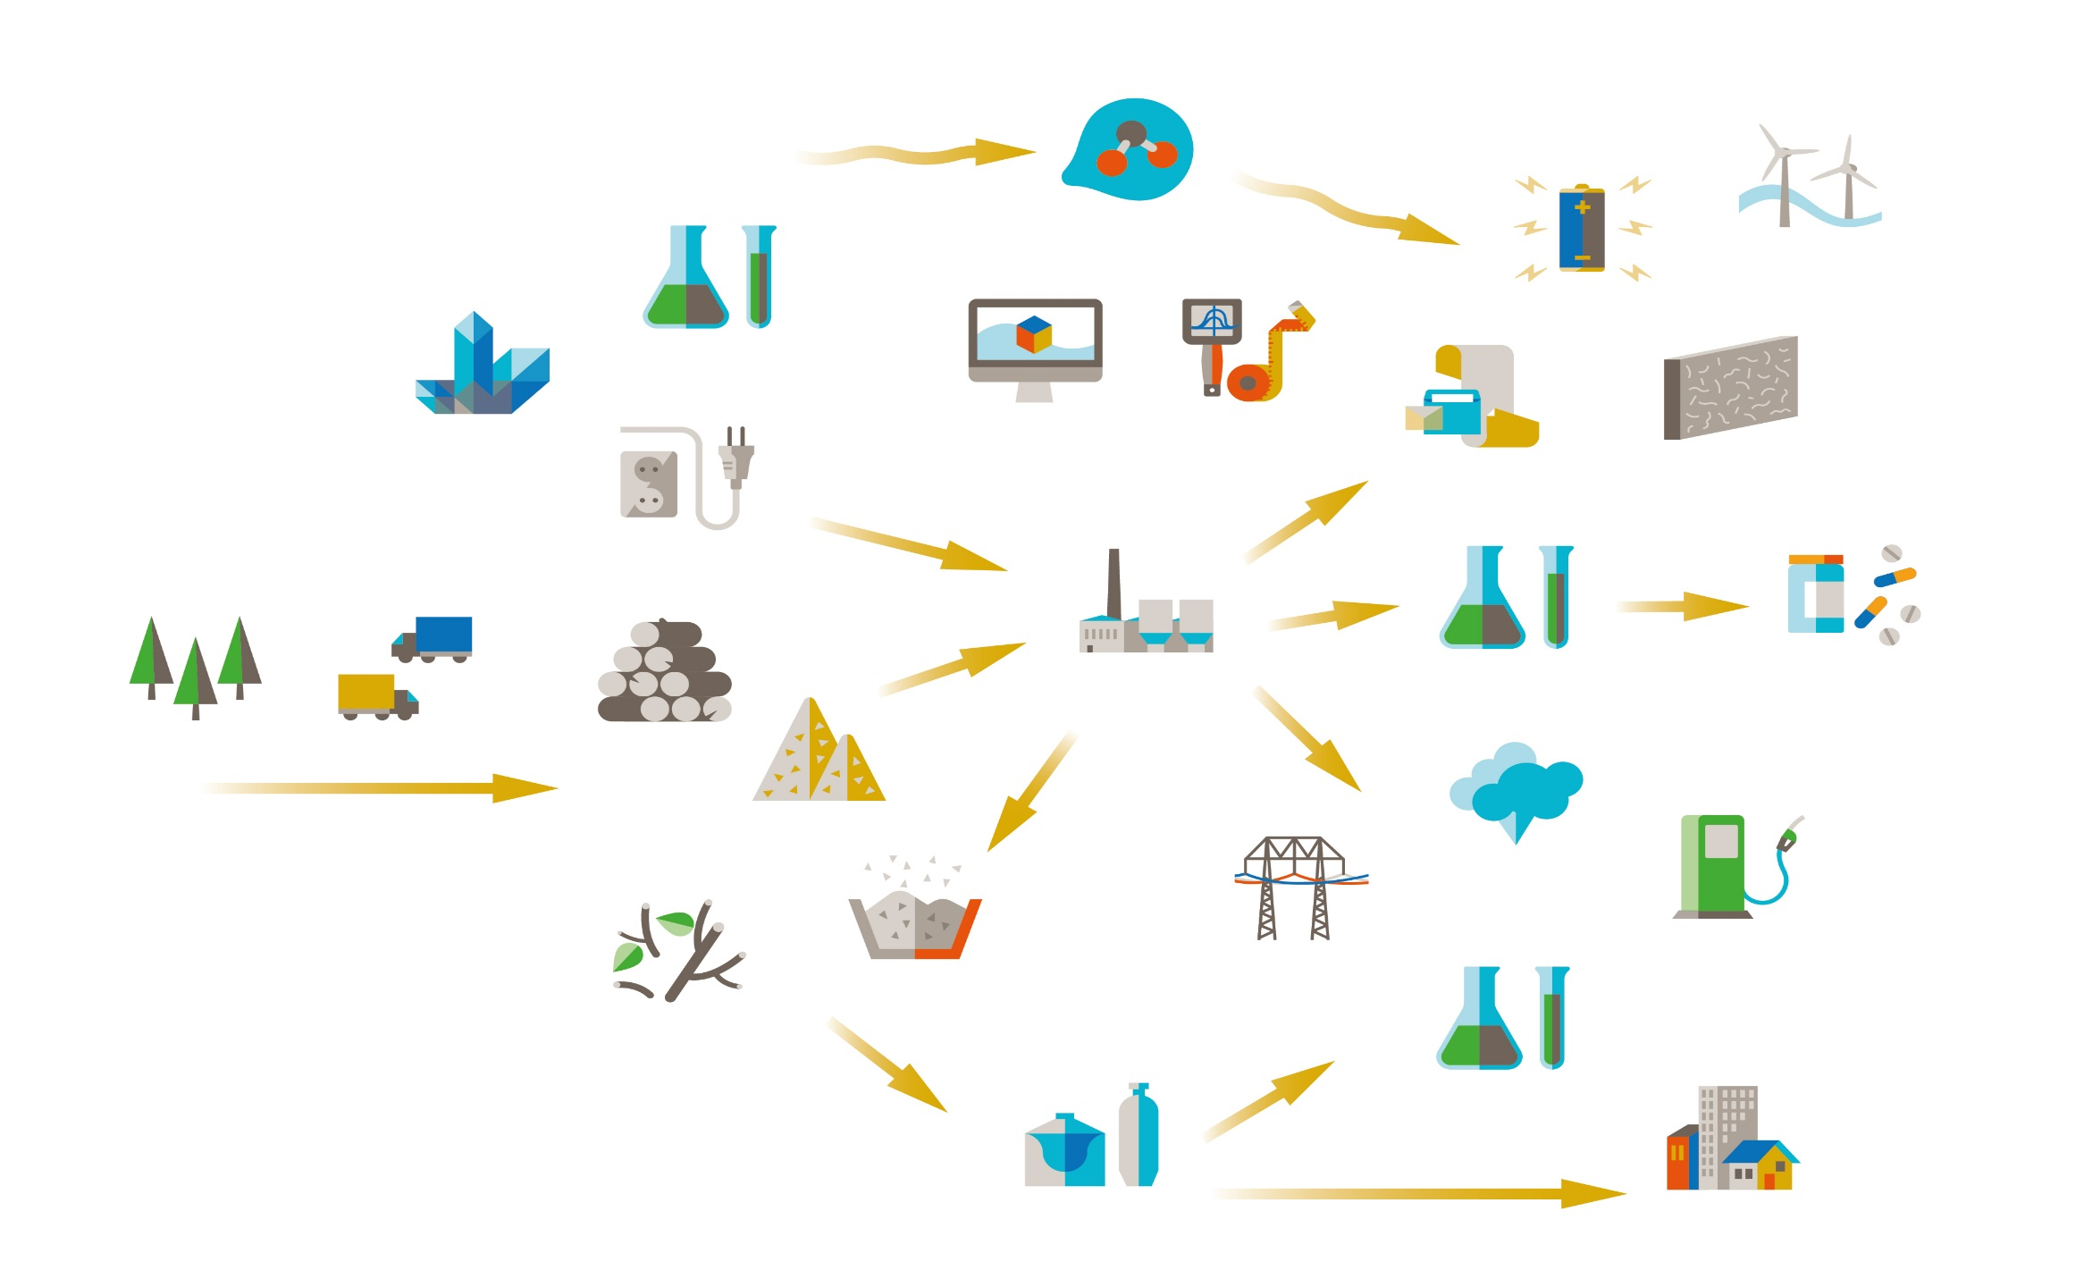
FORIC - companies
Mantex
Sylvestris
Tärnsjö garveri
Pulp Eye
SCA Forest Products
Skogforsk
Valmet
SenseAir
SCA Timber
Stora Enso
Kvarnsveden
Frontway
Innventia
Ragn Sells
MoRe research
Sundsvall Energi

Slide 18
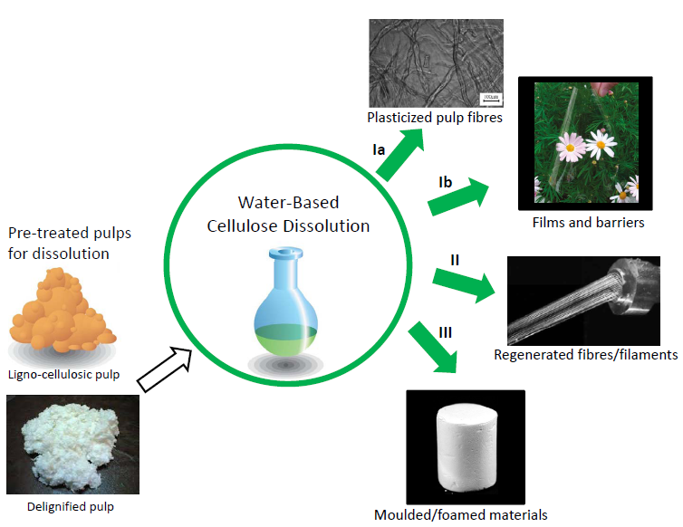
New cellulosic materials
Expand FSCNs industrial network
Goal: Research program on advanced biomaterials
  Water-based cellulose dissolution
  Fibrous materials: FNMech and AHYP
Effect on research profile
  National (BioInnovation) and international visibility
  Link our competence on High-Yield Pulping etc. with KM2
Support to TIE vision
  Regional value from BioInnovation
  Prototyping platform with BBA

Slide 19

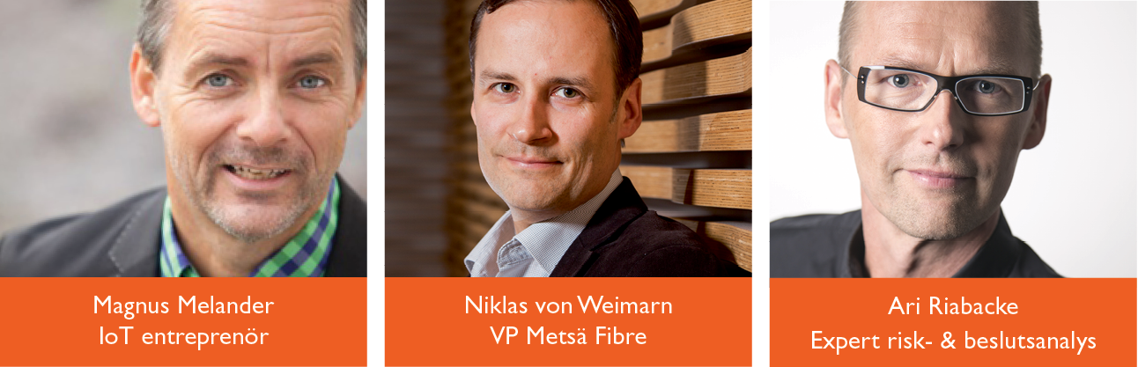
Science Innovation Day
Regional innovation conference with FOV and BBA
Research in focus – show our results
Posters and demonstrators – exhibition area
Get new inspiration
Find new partners and cooperation

Slide 20


Business Innovation Day
AIM-Day for company challenges
Documentation
Startpoint of new projects
Until now:
  25 company challenges
  9 new research projects

Slide 21




Spin-offs
hysch
Concrete
new business
World-class science
Unique support to industry

Slide 22



Research to develop knowledge and opportunities!

