Slide 1
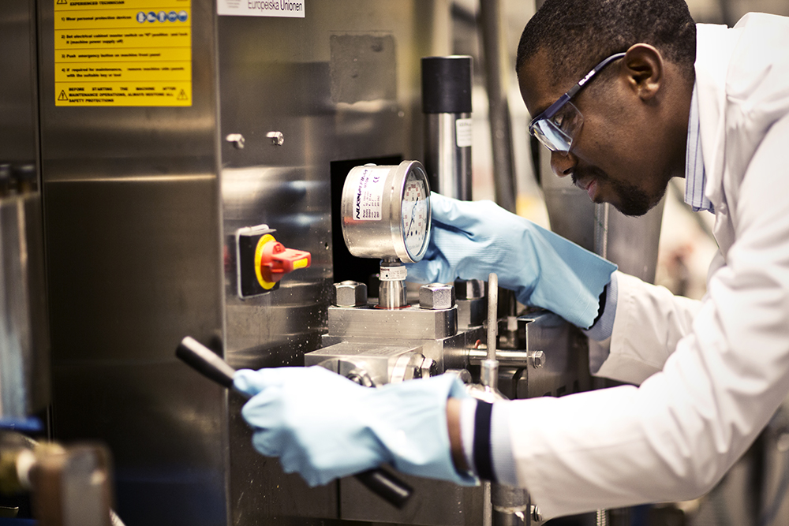
Presentation Workplan 2016-2018
Dialog om VP 2016 för Miuns KK-miljö

Slide 2
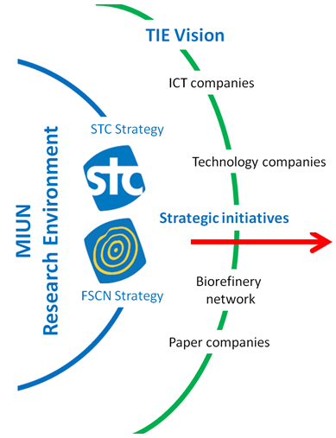
Research Environment with a mission and vision to support Transformation of the Industrial Ecosystem
New strategic position
Joint vision for STC and FSCN Centres
Competence – strong research environment
Content – strategic research program
Coproduction – strong culture
→ Research Environment for Transformative Technologies

Slide 3


Strategic Framework
¹ Analysts and consultants call on businesses to create more value through innovation, yet most companies have been optimized to provide greater efficiency, not greater innovation. As a result, any innovation-driven strategy will likely falter unless we fundamentally reframe our strategic thinking.
¹ In particular, we must regrind our lenses to monitor the periphery, that is, the edges, of our business. At these edges lie our richest opportunities for value creation and our strongest protection against value destruction.
Core – resource efficiency
Edge – new businesses

Slide 4
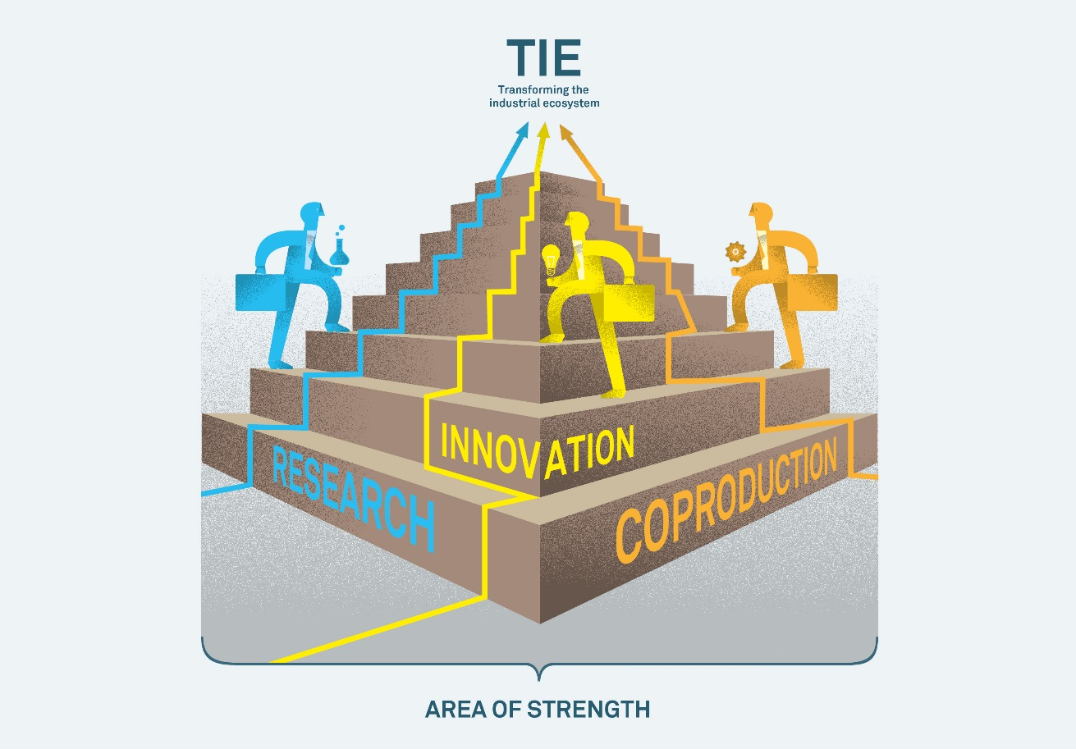
TIE – Transforming the Industrial Ecosystem (Boundary conditions)
Exploit the competitive advantages of the region
Choose opportunities from a global perspective
Use information technology as a key enabler
Adapt to changing markets
Supply competence and skills
Profile the most exciting future opportunities

Slide 5
Our original research focus
EISS
Measurement
Systems
KM2
Core – resource efficiency
FORIC
New Cellulosic
Materials
e2mp
Edge – new businesses

Slide 6
Support to Transformation
”IoT”
Process control as a service
ABB
ÅF, Analog Devices
Eurocon
New energy
systems
Environmental sensors
SensAir
Iggesund
ABB
ÅF, Hägglunds
Sundsvall Energy
Vattenfall
SensAir
Saab Combitech
Spinn-offs
EISS
Measurement
Systems
KM2
STT Emtec
Superior Graphite
Sol Voltaics
Core – resource efficiency
Bioeconomy
FORIC
New Cellulosic
Materials
Ragn-Sells
Valmet, SCA, Frontway
e2mp
Billerud Korsnäs
SCA, Stora Enso
Metso
Edge – new businesses
SCA, Stora Enso
Holmen
Metso
Biomaterials

Slide 7



The strategic process – step by step
Towards a sharper Vision

Slide 8
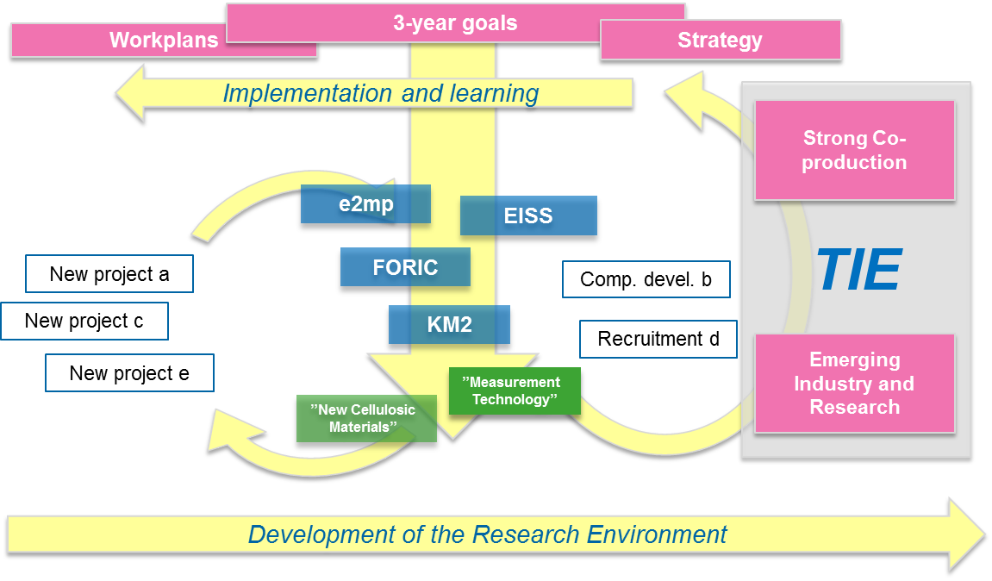
New strategic actions

Slide 9
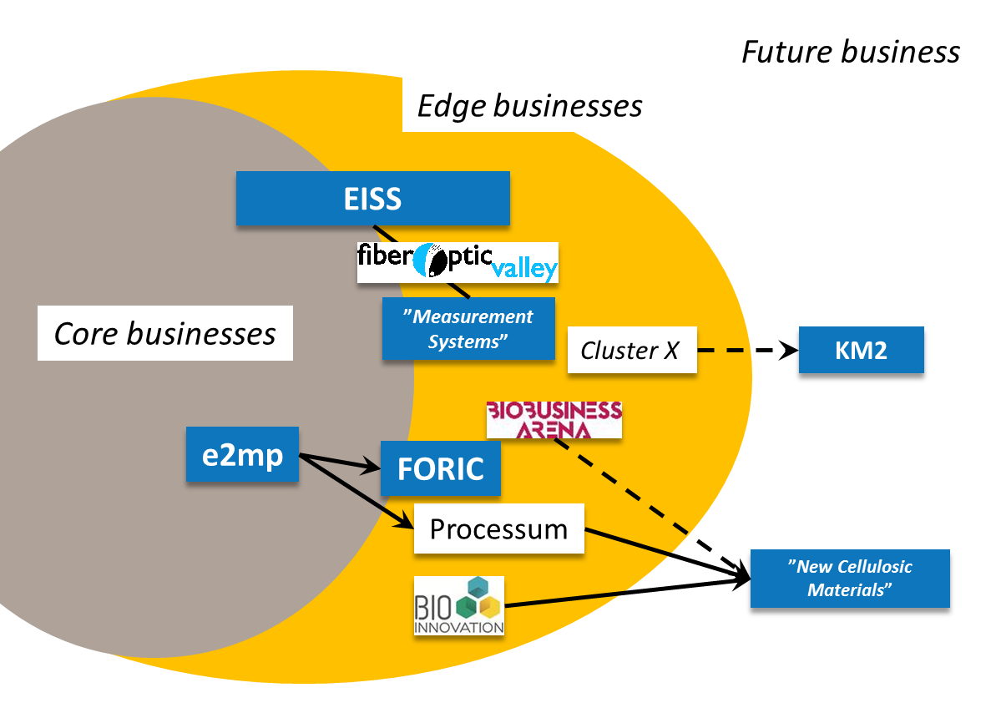
Support Core and Edge

Slide 10
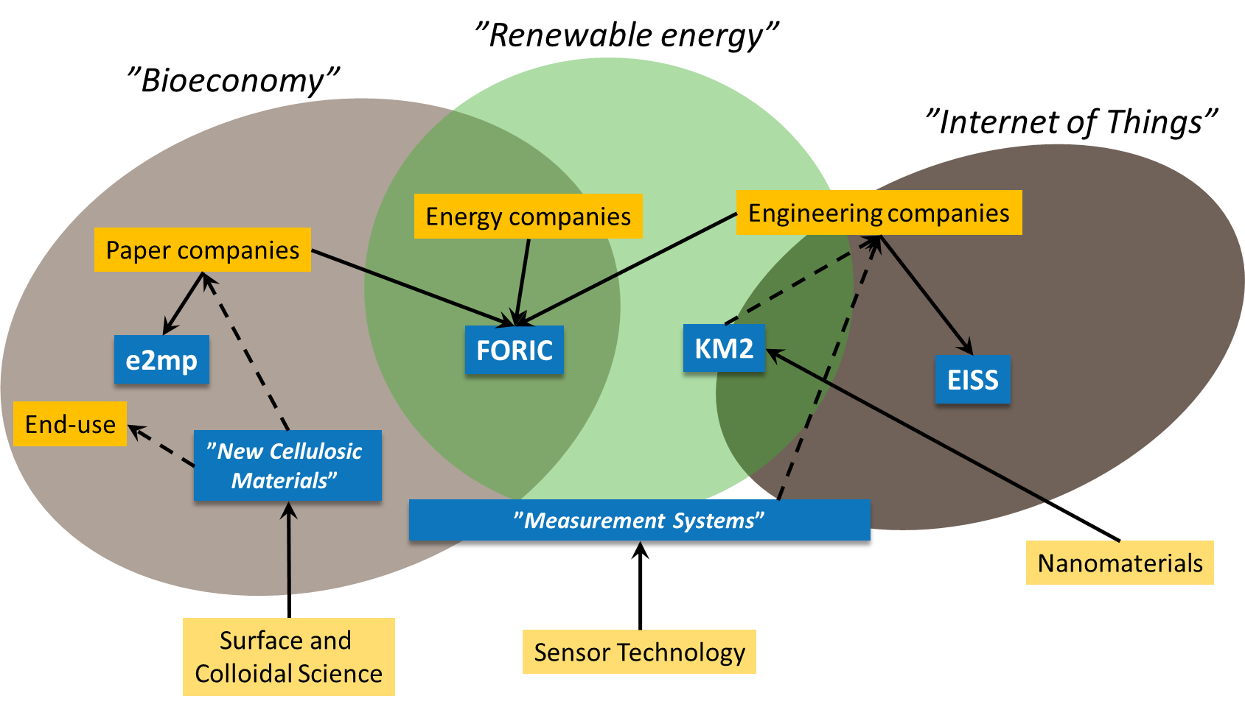
Emerging Business Areas

Slide 11

Portfolio
e2cmp
Paper
Solar Cells
ENCCP
TINA
e2mp-rp
ASIS
SURF
MOVEMENTS
AHYP
GRIT
JOKER
= Existing actions
FNMech
kW Converter
X-COAT
= WP2016-Education
New Cellulosic
Material
KM2
e2mp
EISS
Measurement
Systems
= WP2016 - Recruitment
KM2CHAMP
M2M
= WP2016 - Research
BRESCIA
STC
IMAGIC
TRANSFORM
FLIS
Light-Weight
LEAP
ID-POS
TIMELINESS
DAWN
DUVA
FORIC – Research School
OCXIS
Education development
SANDAS
Competence at FSCN and STC
Mittuniversitetet

Slide 12
Initiation of new actions 2016
Start up
Dec. 10
Draft
Feb. 1
Proposal
March 11
Full application May 6
  Instructions and templates on website and mail
  Seminar 5/2
  Reference Group 12/2
  Feedback from Vice Deans
  Proposal Template 23/2
  Reference Group 22/3
  Dean: proposal selection 24/3
    Initiate writing and budget process
    Suggest external reviewers 7/4
  Internal review
  call fullfillment
  External review reports due 17/6
  Re-review
  mid August - 1 Sept
  9/9: Revised application incl budget and CVs
  Advisory committee
  Reference Group
  Faculty board
  Dean selects actions for VP

Slide 13

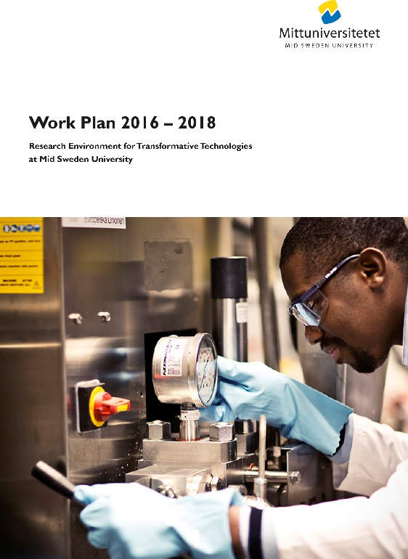
Reporting process
Progress Report
Work Plan
3 Year Plan

Slide 14
Reporting process
WHAT
Progress Report (March), and Work Plan (October)
Input information (documented in Box):
  Status reports of projects (PR and WP)
  Indicators (PR)
WHY – Build a strong research environment
Analyze progress towards the strategic goal
Learn what works well
Plan the most effective actions

Slide 15
Reporting process
CHALLENGES
Internal communication before and after reporting?
Collection of input information?
Focus to research results and conclusions?

Slide 16
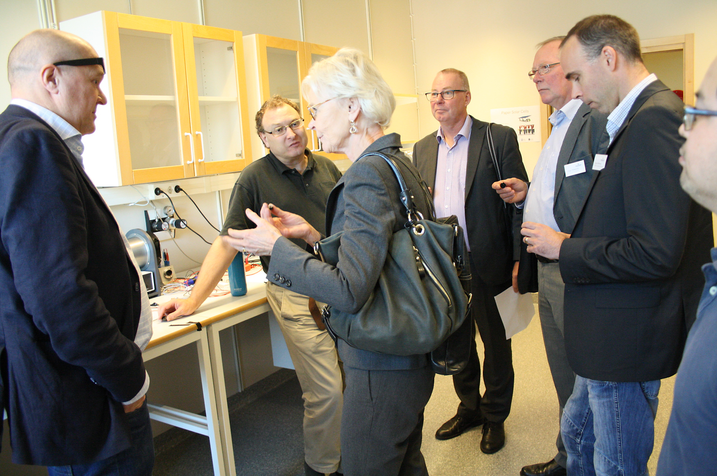
Communication process
Visualise research and co-production

Slide 17
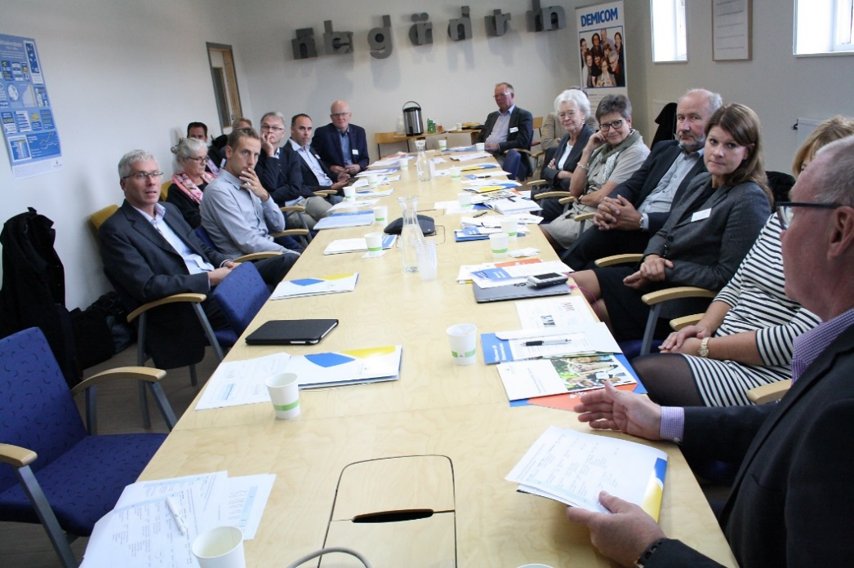
Communication process
WHAT - Visualise research and co-production based on TIE Vision
New research projects
New activities in the projects
Results
WHY - Demand from financier and Miun
WHO - Target audience
Financiers
Partners - existing and potential
Colleagues in FSCN/STC and Miun
Others… researchers, county board, municipality, public and the Swedish King
Notes:
New projects presented on the website with projectmembers, logotypes from partner companies and financiers.
Research results: send a press release if we have results that we can communicate.
The goal is to visualise research and co-production.
Why: Satisfy the partner and financiers requirements.
We need the information to support your activities.
We can support your communications
Grundkrav att vi måste enligt KK-stiftelsen. Vi vinner på att kommunicera, vi synliggör för bef partners och vi hittar nya. Ringar på vattnet…

Slide 18
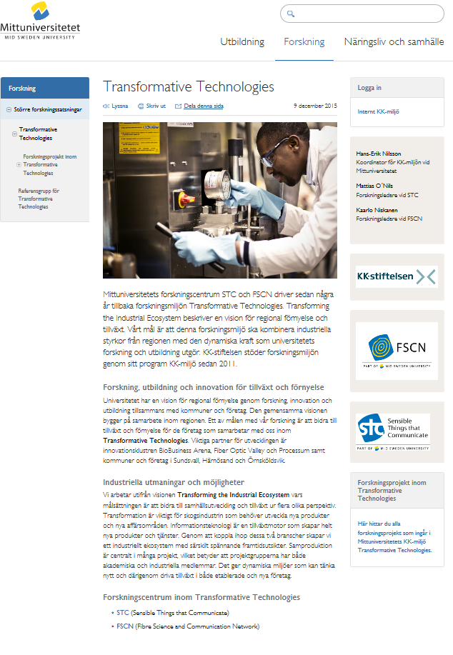
Communication process
HOW - Support your communication
Channels
Website
Newsletters
Press releases
Programs / Invitations / Visits
Social media – Facebook, twitter etc
Business Innovation Seminars
Business Innovation Day
Science Innovation Day
Notes:
The website is our main channel for communication. Our research centres have approx 600 pageviews /week.
We have specifik pages for the research environment Transformative technologies – both in Swedish and English.
We write digital newsletters to highlight news from the website.
We write pressreleases when we have news to tell specific news for related business media.
We work with documentation of events. With photos to make the website a bit more personal.
The best communication effect is often better with a mix of channels…

Slide 19

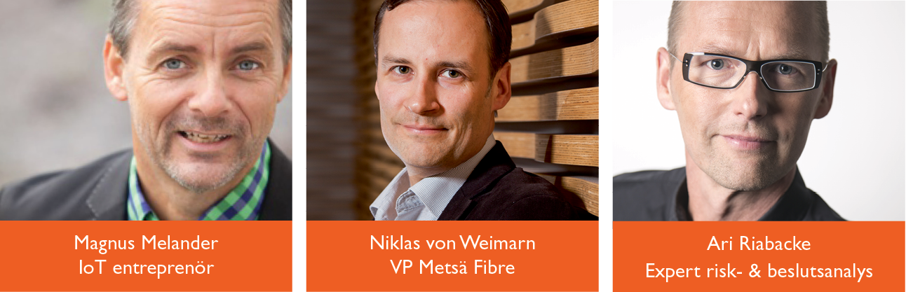
Science Innovation Day
Regional innovation conference with FOV and BBA
Research in focus – show our results
Posters and demonstrators – exhibition area
Get new inspiration
Find new partners and cooperation
Notes:
Four conferences in one: We cooperate with STC FSCN FOV and BBA.
The internal need is to get new inspiration, find new partners and cooperation. Also to show our research results.
We meet many of target audience – financiers, partners, society, colleagues.

Slide 20


Business Innovation Day
An easy way for a company to meet researchers
Documentation and follow up
Startpoint of new projects and cooperations
Until now:
  25 company challenges
  9 new research projects
  Exwork for students at Miun
Notes:
The companies can send in challenges and we match them with the right researchers in our research areas.
On the meeting day there will be short workshops with company members and researchers. One hour to brainstorm idéas and discuss solutions.
Afterwards the company will get documentation and a follow up meeting.
We can use this day as a start up day for new research projects. If a company contacts you to start a research you can ask them to send in a challenge. If it is secrecy we can handle the NDA also.

Slide 21
Communication process
CHALLENGES
How can we develop Science and Business Innovation Days?

Slide 22

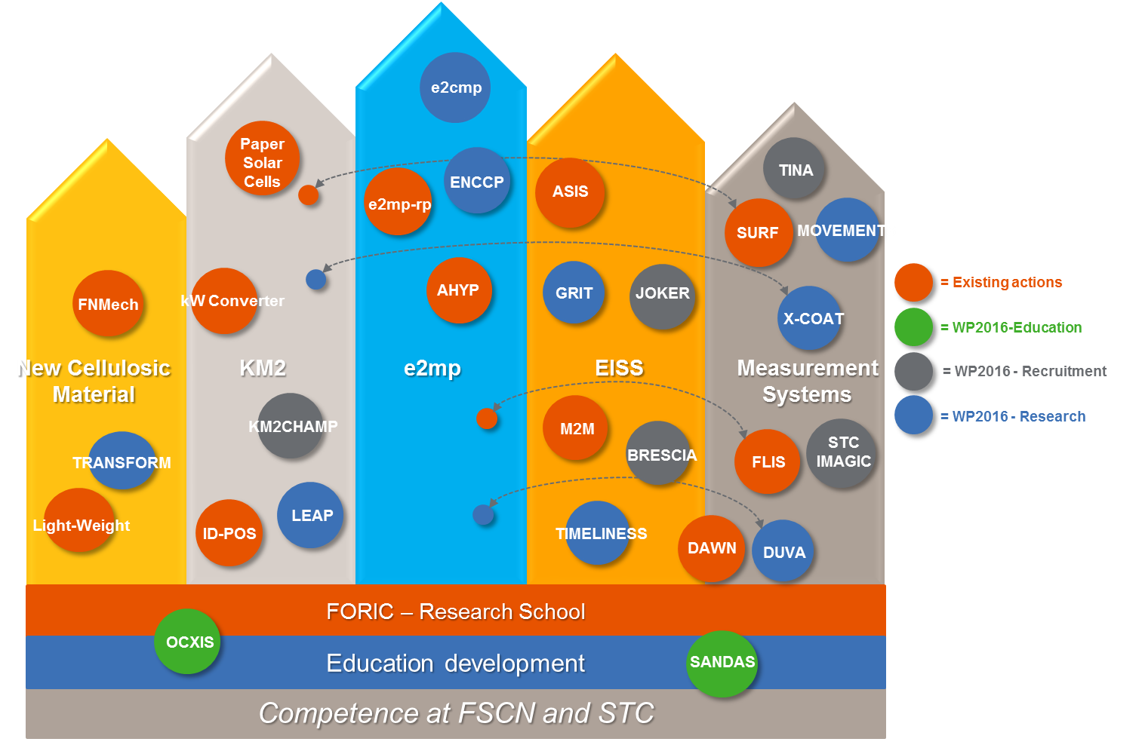
Strategies
Vision – Impact perspective
Strategy

Slide 23
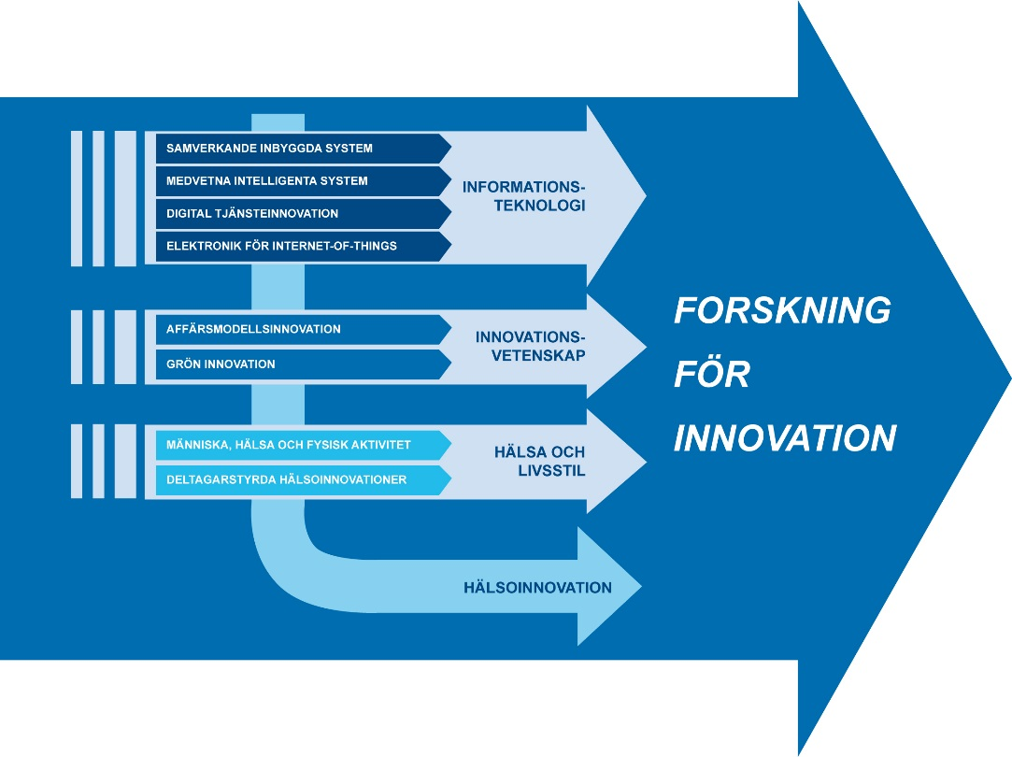
Our neighbors…
Skövde
  INFINIT är att söka lösningar på aktuella problem och utveckla morgondagens innovationer inom områdena Informationsteknologi, Systembiologi och Virtuella system.
Halmstad

Slide 24
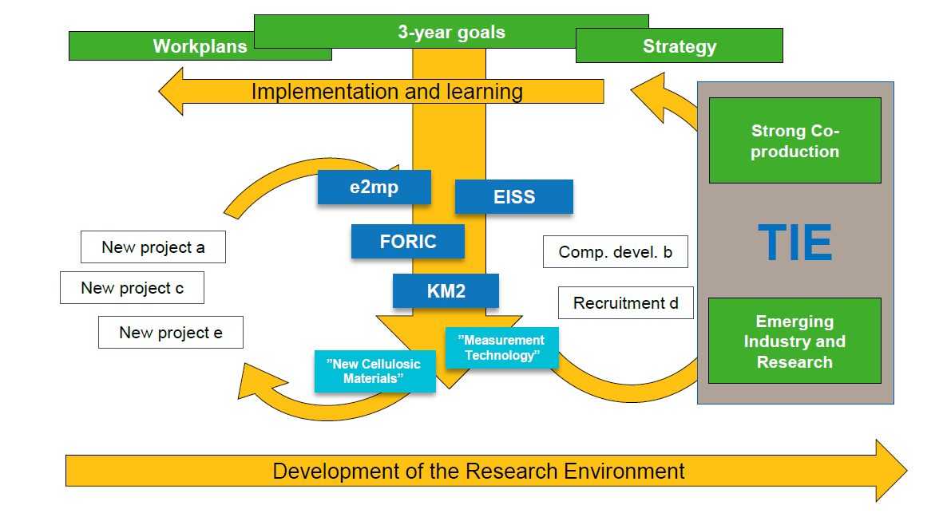
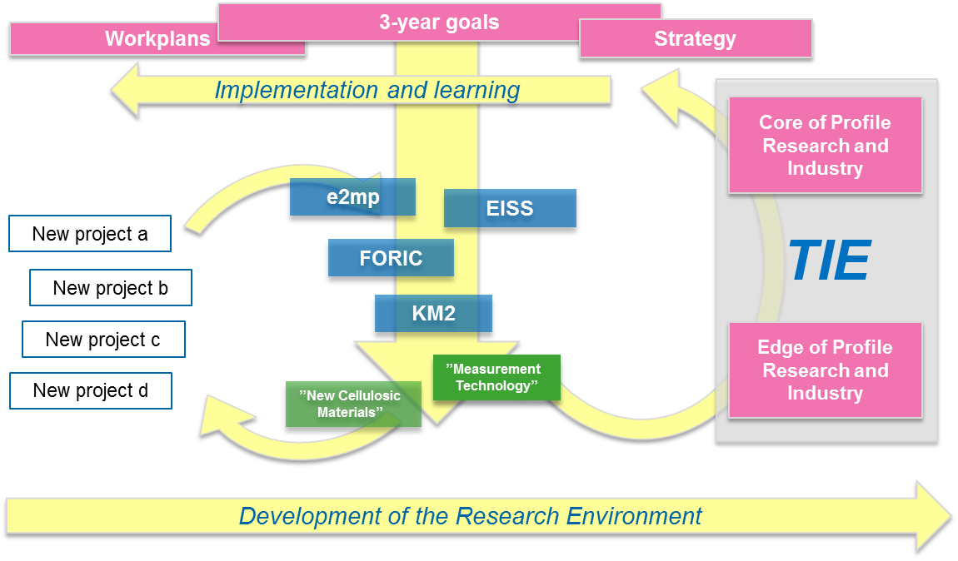
Strategies
WHY?
The KK-environment demands us to motivate our portfolio and show that we develop our whole research environment
WHEN and HOW?

Slide 25
Strategies
CHALLENGES
How is it to live in a KK-environment?
Simplifications on the strategic story?
Improvement of the strategic development?

Slide 26
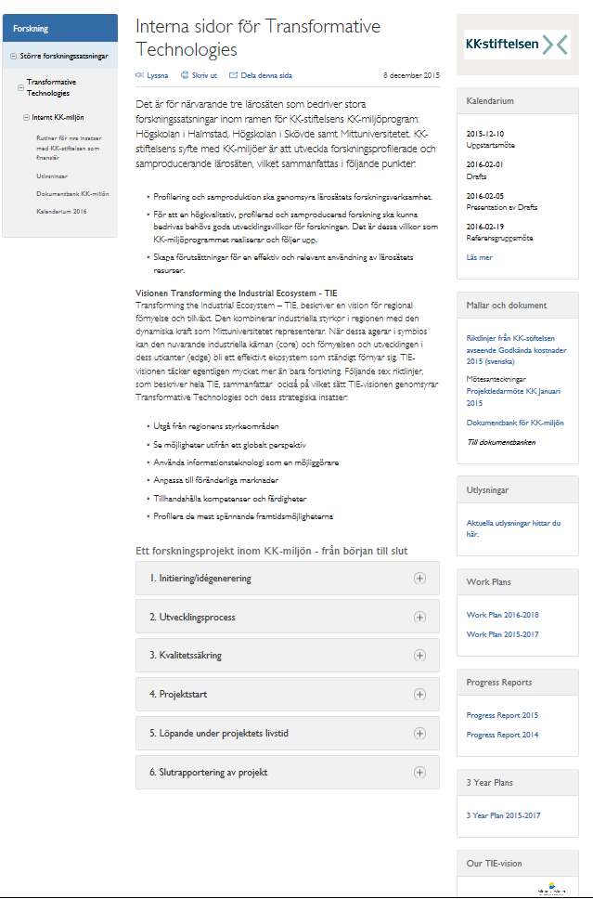
Initiation of new actions
Process description on internal pages
Templates
Timetables
E-mail
Fanny and Maria

Slide 27
Initiation of new actions 2016
Start up
Dec. 10
Draft
Feb. 1
Proposal
March 11
Full application May 6
  Instructions and templates on website and mail
  Seminar 5/2
  Reference Group 12/2
  Feedback from Vice Deans
  Proposal Template 23/2
  Reference Group 22/3
  Dean: proposal selection 24/3
    Initiate writing and budget process
    Suggest external reviewers 7/4
  Internal review
  call fullfillment
  External review reports due 17/6
  Re-review
  mid August - 1 Sept
  9/9: Revised application incl budget and CVs
  Advisory committee
  Reference Group
  Faculty board
  Dean selects actions for VP

Slide 28
Quality process
Committments towards KKS
Seminars
External and internal reviews
Reference group
New: advisory committee
3-years plan
TIE-strategy
MIUN´s research strategy

Slide 29
Initiation of new actions and quality process
WHY regulations for KK-environment program 10 year
Freedom with responsibility
develop forms and culture to strategically develop and profile the university in purpose to support the development of a highly profiled and research intensive environment
WHAT high scientific and co-production quality
call fullfillment
strategic relevance
HOW Internal review of call fullfillment
external review of scientific and coproduction quality
advisory commitee
Reference group on strategic relevans

Slide 30
Initiation of new actions and quality process
CHALLENGES
Timetable 9 months forward planning
Instructions internal and external
Forms and templates
draft, proposal, review report
Review criteria – beyond KKS requirements?

